Slide 1

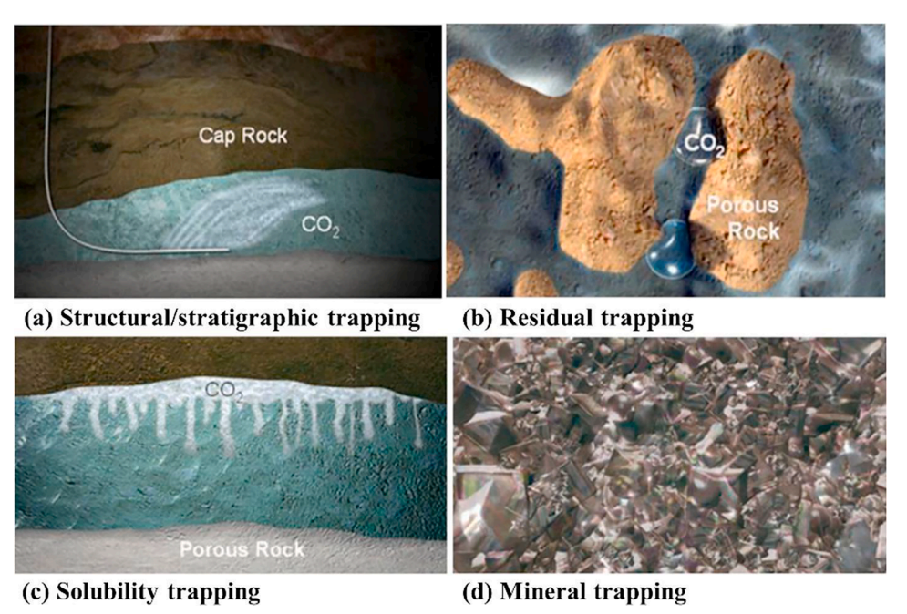
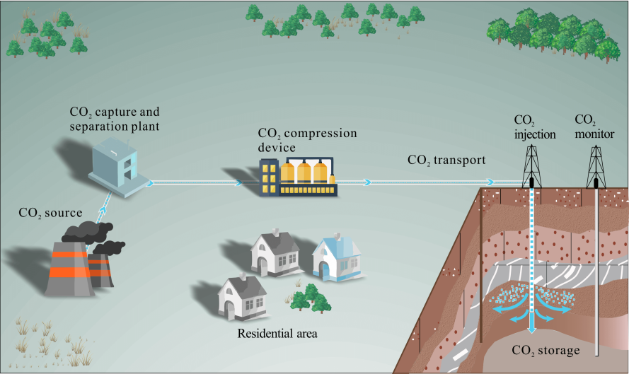
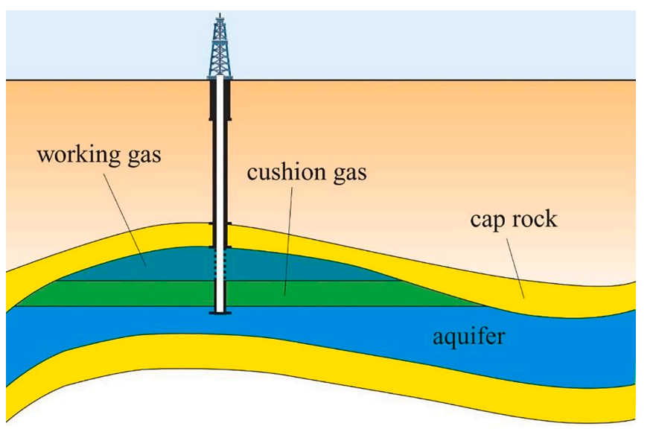
Injection and storage of carbon dioxide gas in depleted oil and gas reservoirs in order to increase oil extraction and preserve the environment
Mohammad Amin Behnam Motlagh¹, Amir Hoseein Saeedi Dehaghani^{1*}, Hadi Tanhaei¹
¹ Department of Petroleum Engineering, Faculty of Chemical Engineering, Tarbiat Modares University, Tehran, Iran
Abstract
Dominant trapping mechanisms include dissolution and mineral trapping in basaltic and sedimentary contexts. Figure 2 illustrates the CO2 gas trapping mechanisms within an underground reservoir.
CO2 storage in depleted oil and gas reservoirs entails the collection, dehydration, and compression of CO2, followed by its injection as liquid or supercritical CO2 for secure storage. The technologies utilized in enhanced oil and gas recovery with CO2 are comparable to those necessary for CO2 storage. As depicted in Figure 3, the CO2 storage workflow in depleted reservoirs is categorized into stages: CO2 collection, treatment, injection, storage, and monitoring.
Cap rock integrity is paramount for assessing long-term CO2 storage safety in depleted reservoirs. Critical considerations include the physical dimensions of the oil and gas column and the cap rock's resistance to CO2-induced changes. Cracks and faults may facilitate CO2 migration, particularly under pressure variations and chemical reactions, which could induce fault activation or slip. The interaction of dissolution and mineral precipitation necessitates further examination of crack dynamics. The dynamics of two-phase fluid flow are governed by the interplay of viscous, capillary, and gravitational forces. The safe storage of CO2 is contingent upon the dominance of capillary and viscous forces over buoyancy, ensuring CO2 retention in rock pores. In depleted reservoirs, the presence of acid-sensitive minerals and substantial formation water critically influences CO2 storage capacity. The interactions among CO2, reservoir rock, and formation water are shaped by rock type, temperature, pressure, and water salinity. Rock wettability significantly affects the injectivity and storage integrity of CO2. Nonetheless, the quantitative relationship between contact angle and CO2 leakage simulations remains underexplored.
Salt deposition, resulting from gas-liquid leakage and mineral crystallization, primarily occurs near high-flow CO2 injection wells. This phenomenon diminishes CO2 leakage risk through faults, yet the specific mechanisms of salt deposition in the context of multiphase fluids remain inadequately understood. Well leakage poses a substantial risk for CO2 escape, as infiltration into the cement matrix may lead to structural degradation. CO2 infiltration creates varied zones within the cement matrix, including calcium carbonate and silica gel formations, heightening leakage vulnerabilities. To mitigate this risk, the use of corrosion-resistant cement and acid-resistant alloys is advisable. Repressurizing depleted reservoirs to original or lower levels may alter the cap rock's elastic properties and induce failure. Alterations in pressure and stress can drive capillary leakage and microcracking within the cap rock. Although the implications of these factors for CO2 storage are well-documented, the link between micro-scale trapping mechanisms and macro-scale storage outcomes remains inadequately articulated. Further research is warranted to elucidate how supercritical CO2 modifies rock wettability in a CO2-water-oil three-phase system and affects leakage pathways through faults.
The recent increase in greenhouse gas emissions from fossil fuel combustion has caused significant environmental harm and initiated global warming. Carbon dioxide is the principal contributor to global warming. Therefore, carbon dioxide is a serious environmental pollutant warranting thorough examination due to its crucial influence on climate change. Consequently, various strategies have been proposed, including the injection of carbon dioxide into depleted oil and gas reservoirs. Studies have shown that the geological cap used for previous oil and gas containment can be repurposed to immobilize newly injected carbon dioxide and prevent its upward movement. Depleted oil and gas reservoirs present superior geological storage options in comparison to deep saline reservoirs. Understanding the optimal pressure for carbon dioxide injection is vital for reservoir engineers concerning the potential storage capacity of these reservoirs. Ultimately, the injection and storage of carbon dioxide in depleted oil and gas reservoirs not only aids in mitigating greenhouse gas emissions but may also enhance oil recovery, thereby providing economic advantages for oil-producing nations.
Technical Processes
Introduction
Conclusion
The European Union and several countries aim for carbon neutrality by 2050. This reflects a global initiative in carbon dioxide management. Key geological formations for carbon storage include depleted reservoirs and deep saline aquifers. Depleted hydrocarbon reservoirs are ideal for gas storage due to their geological reliability and infrastructure. The cap rock in these reservoirs is confirmed to be impermeable. Residual gas in these reservoirs is beneficial, serving as cushion gas. Depleted gas reservoirs typically exhibit low pressure and high water saturation from aquifer water displacement. Essentially, they function as aquifers with minimal pore water, primarily containing trapped gas. Figure 1 depicts a depleted gas reservoir, highlighting essential elements for secure operations: (a) a suitable formation for CO2 storage, (b) an impermeable cap to prevent migration, and (c) an anticlinal trap to restrict lateral CO2 movement, facilitating effective accumulation.
In this article, the exploration of gas trapping mechanisms and the assessment of geological and engineering factors aims to support engineers in identifying suitable CO2 storage sites and expediting related efforts.
Gas storage in depleted reservoirs is a recognized practice, with initial documentation from 1915 in Ontario, Canada. Since that time, parallels between various storage operations have been leveraged to enhance understanding of hydrogen behavior underground, albeit with unique considerations for CO2 storage. Ali et al. (2022) noted that structural/stratigraphic trapping is prevalent in CO2 storage, while residual/capillary trapping is common in sedimentary formations.
This article investigates CO2 storage in depleted oil and gas reservoirs for enhanced oil recovery. The method offers high capacity, effective CO2 containment, extensive reservoir knowledge, established well infrastructure, and ease of implementation. However, careful evaluations are necessary to choose the suitable reservoir. Factors affecting storage encompass geological elements (cap rock, faults, capillary pressure) and engineering aspects (well integrity, injection pressure). Future research should focus on the interplay between micro-scale trapping mechanisms and their macro-scale effects on the reservoir. Furthermore, corrosion-resistant materials ought to be utilized in well structures to prevent leakage. The principal CO2 trapping mechanisms consist of structural/stratigraphic trapping, capillary trapping, dissolution trapping, and mineral trapping. Nevertheless, a thorough comprehension of the simultaneous operation of these traps, particularly at micro- and nano-scales under high pressure and temperature, remains insufficient. Additional research is essential to elucidate CO2 behavior, solubility, and phase transitions in complex geological settings. The assessment of CO2 storage potential comprises basin selection, reservoir selection, storage security evaluation, and capacity calculation. For capacity calculations, it is advisable to employ a numerical reservoir model that accounts for various heterogeneities.
Geological and Engineering Factors Affecting the Storage Process in Depleted Reservoirs
References
[1] B. Wei, B. Wang, X. Li, M. Aishan, and Y. Ju, “CO2 storage in depleted oil and gas reservoirs: A review,” Advances in Geo-Energy Research, vol. 9, no. 2, Art. no. 2, Jul. 2023, doi: 10.46690/ager.2023.08.02.
[2] R. Tarkowski, “Underground hydrogen storage: Characteristics and prospects,” Renewable and Sustainable Energy Reviews, vol. 105, pp. 86–94, May 2019, doi: 10.1016/j.rser.2019.01.051.
[3] R. L. Wallace, Z. Cai, H. Zhang, K. Zhang, and C. Guo, “Utility-scale subsurface hydrogen storage: UK perspectives and technology,” International Journal of Hydrogen Energy, vol. 46, no. 49, pp. 25137–25159, Jul. 2021, doi: 10.1016/j.ijhydene.2021.05.034.
[4] M. Lysyy, M. Fernø, and G. Ersland, “Seasonal hydrogen storage in a depleted oil and gas field,” International Journal of Hydrogen Energy, vol. 46, no. 49, pp. 25160–25174, Jul. 2021, doi: 10.1016/j.ijhydene.2021.05.030.
[5] R. Tarkowski, “Perspectives of using the geological subsurface for hydrogen storage in Poland,” International Journal of Hydrogen Energy, vol. 42, no. 1, pp. 347–355, Jan. 2017, doi: 10.1016/j.ijhydene.2016.10.136.
Gas Trapping Mechanisms

