Slide 1




Investigating the Effects of Porous Media on the Minimum Miscibility Pressure
of an Asphaltenic Oil Sample and Gas
Fatemeh Keyvani Ali Safaei
Yousef Kazemzadeh Masoud Riazi
Jafar Qajar
September 2024
Tehran University

Slide 2
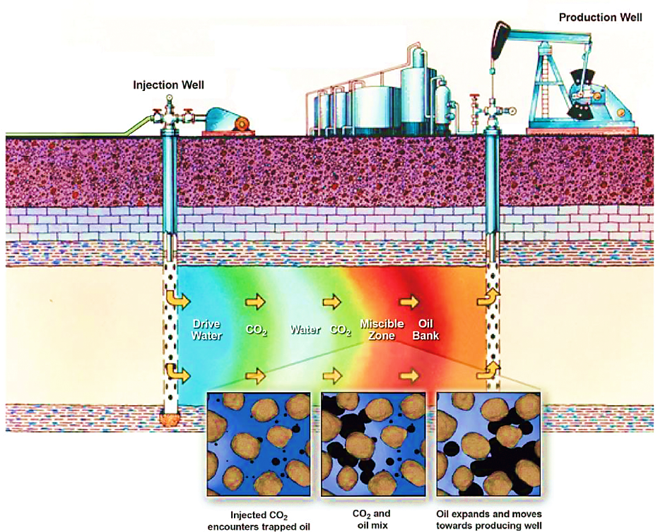
Gas Injection:
One of the Most Important EOR Methods
Three types of gas injection:
Miscible
Immiscible
Near miscible
The minimum miscibility pressure (MMP) between oil and gas is a key parameter.
1
Ref. : (Nwidee et al., 2016)

Slide 3
MMP Calculation Methods
Experimental Techniques
Empirical Correlations
Numerical Simulations
costly and
time-consuming
limited range of
operating conditions
such as Equations of Satate (EoS) are promising tools
2

Slide 4
Factors Affecting MMP in Porous Media
1. Confinement Effects
2. Asphaltene Precipitation
Shift of critical properties
Adsorption
Capillary pressure
Asphaltene accumulates on the oil-gas interface and influence their miscibility process.
3

Slide 5
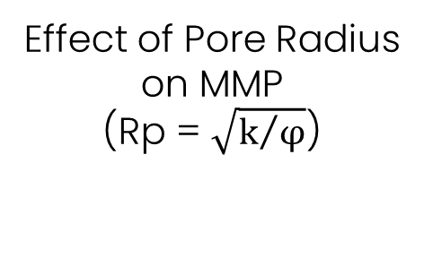
Problem Statement
Research Objectives
Confinement
Effects
Effect of Pore Radius
on MMP
(Rp = $\sqrt{k/φ}$)
Effect of Asphaltene
Precipitation on MMP
Asphaltene Precipitation
Effect of Injected Gas
on MMP
4

Slide 6

Modeling
Confinement Effects
Asphaltene Precipitation
Modified PR-EoS
Shift of critical properties
Adsorption
Capillary pressure
CPA-EoS
Cubic part:
Modified PR-EoS
Ref. : (Song et al., 2021)
Ref. : (Li & Firoozabadi, 2010)
a more comprehensive model
considering both confinement and asphaltene precipitation
5

Slide 7
Model Output
6
Schematic of model output
Data from : (Kazemzadeh et al., 2018)

Slide 8
Model Validation
Test | It measures: | Is it conducted in porous media? | Output | Limitations
VIT | FCM (second slop of IFT curve) | No | IFT vs. pressure | a drop of oil is contained within a gas chamber and the overall gas-oil composition is not measurable.
Slim tube | MCM (first slop of IFT curve) | Yes | Recovery factor vs. pressure | its output is not directly comparable with the output of the model.
Refer to (Keyvani et al., 2024) for more information about validation process and its challenges.
7

Slide 9
Effect of Asphaltene Precipitation
CO2
NGL
T = 372 K, Rp ≅ 112 nm
(k = 1 mD , ϕ = 8%)
8

Slide 10
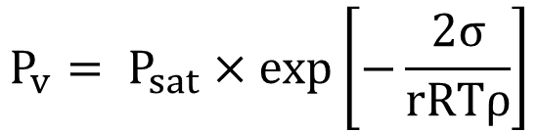
Effect of Pore Radius
Kelvin equation:
$$P_{v}= P_{sat}×exp\left[−\frac{2σ}{rRTρ}\right]$$
r
Pv
9
CPA-EoS, T = 372 K

Slide 11
Conclusion
Confinement effect was more crucial when the pore radius was less than 100 nm.
The calculation of MMP in unconventional tight reservoirs such as shale reservoirs should be performed more accurately.
The competition between the two phenomena of solubility and accumulation of asphaltene on the interface determines the miscibility conditions between oil and gas.
The reservoirs that are chosen for CO2 injection and storage will be more prone to asphaltene precipitation and resulting damage.
10

Slide 12

References
Kazemzadeh, Y., Eshraghi, S. E., Riazi, M., & Zendehboudi, S. (2018). How do metal oxide nanoparticles influence on interfacial tension of asphaltic oil-Supercritical CO2 systems? The Journal of Supercritical Fluids, 135, 1-7.
Keyvani, F., Safaei, A., Kazemzadeh, Y., Riazi, M., & Qajar, J. (2024). Impact of nanopore confinement on phase behavior and enriched gas minimum miscibility pressure in asphaltenic tight oil reservoirs. Scientific Reports, 14(1), 13405.
Li, Z., & Firoozabadi, A. (2010). Cubic-Plus-Association Equation of State for Asphaltene Precipitation in Live Oils. Energy & Fuels, 24(5), 2956-2963.
Nwidee, L. N., Theophilus, S., Barifcani, A., Sarmadivaleh, M., & Iglauer, S. (2016). EOR processes, opportunities and technological advancements. Chemical Enhanced Oil Recovery (cEOR)-a Practical Overview, 20, 225-237.
Song, Y., Song, Z., Guo, J., Feng, D., & Chang, X. (2021). Phase behavior and miscibility of CO2–hydrocarbon mixtures in shale nanopores. Industrial & Engineering Chemistry Research, 60(14), 5300-5309.
Thank You
Q & A

