Slide 1

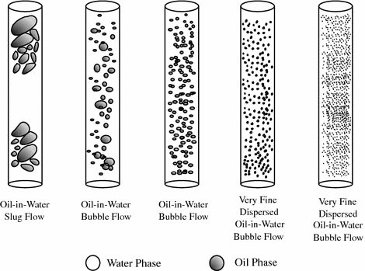
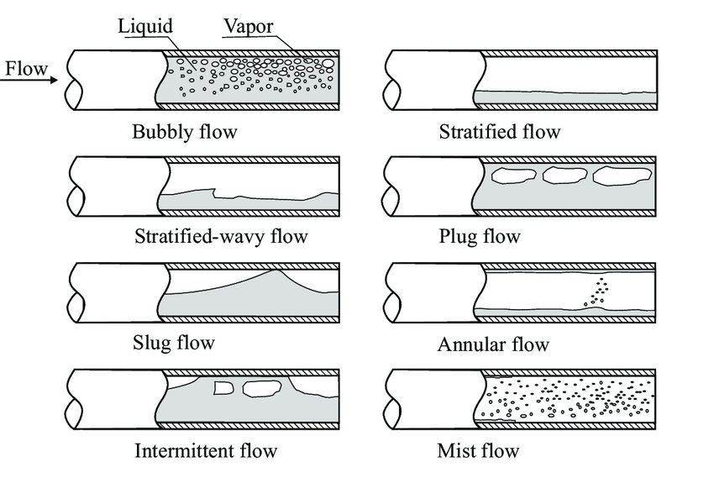
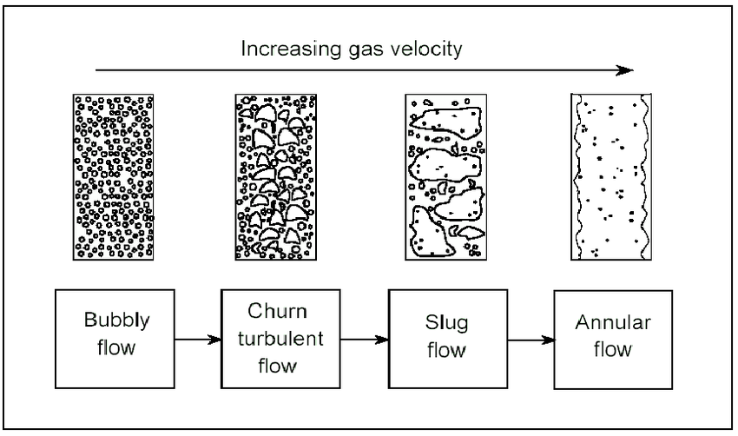
A comprehensive investigation of bubble flow regime behavior for equipment optimization and pipeline design
Hadi Tanhaei ¹ , Amir Hoseein Saeedi Dehaghani^{1*,}Mohammad Amin Behnam Motlagh¹
¹- Department of Petroleum Engineering, Faculty of Chemical Engineering,
Tarbiat Modares University, Tehran, Iran
Abstract
Results and Discussion
In the horizontal pattern mode, the flow is similar to the vertical mode except that the bubbles flow mostly in the upper half of the tube. In horizontal pipelines, in cases where the gas flow rate is relatively low and the liquid flow rate is relatively high, bubbling flow appears as small gas bubbles under the influence of the density difference in the upper part of the pipe. With increasing gas flow rate, the size of the bubbles increases gradually. The apparent velocity of the liquid in this flow regime is between 1.5 and 4.5 meters per second and the apparent velocity of the gas is between 0.3 and 3 meters per second. In 1973, Beggs-Brill proposed three main types of horizontal flow patterns including discrete flow, alternating flow and distributed flow. Based on this definition, a separate flow pattern will be formed when the gas and liquid phases are continuous along the flow axis. If the two phases of liquid and gas flow as alternating packets, an alternating flow pattern will occur. When one of the liquid or gas phases flows continuously and relatively in two stretches parallel and perpendicular to the pipe axis, a distributed flow pattern is formed. In this case, it is not necessary for the other phase to be uniformly distributed in the same part of the pipe, but it must be locally continuous. Bubble flow in horizontal pipelines was included in this category. Figure 2 shows an example of the formation of this type of bubble flow in horizontal pipelines [5].
The end of bubbly flow will be when the bubbles join together to produce a bigger bubble, and this flow regime is called slug flow. This flow has spherical bubbles called Taylor bubbles, and these bubbles are separated from each other by a volume of liquid. This volume of liquid (slug) also usually contains small bubbles.
Bubbly flow is one of the types of gas-liquid two-phase flow regimes in which the gas phase is dispersed in the liquid phase in the form of small bubbles. This type of flow is usually observed at low gas velocities and high liquid velocities and can play an important role in the oil and gas industry. In bubbly flow, gas bubbles tend to accumulate at the top of the tube due to their lower density compared to liquid. This non-uniform distribution of the gas phase in the liquid can affect flow parameters such as pressure drop and mass transfer. Accurate knowledge of the bubbling flow regime and its influencing factors, such as the volume ratio of gas to liquid, fluid velocity and their physical properties, for the design and optimal operation of industrial equipment such as bubble reactors and heat exchangers that use this type of flow. Experimental studies and numerical modeling in this field have led to significant progress in understanding and predicting the behavior of bubbly flow. These developments can help improve the design and efficiency of this industrial equipment. The aim of this research is to provide a comprehensive understanding of the factors affecting the transfer of the bubbly flow regime, to investigate its various applications in different fields and to propose detection methods. By doing this, a new perspective for designing, operating and optimizing the safety and efficiency of pipeline systems will be realized.
In bubbly flow, the gas or vapor phase is dispersed inside the continuous liquid phase in the form of bubbles. In one part of the tube, the bubbles may be very small and spherical, and in the other part, they are large and elongated (spherical head and flat tail). This state occurs when the flow rate of the gas phase is very low compared to the liquid. In this type of pipelines, bubbles move upwards due to gravity. The size of the bubbles usually depends on the speed of the gas phase and the liquid phase, the physical properties of the fluids and the diameter of the pipe, and the size of the bubbles increases with the increase of the speed of the gas phase. Also, in general, the speed of the bubbles is lower than the speed of the liquid phase, and the frequency of bubbles increases with the increase of the speed of the gas phase. In addition, bubbles in vertical pipelines tend to be uniformly distributed in the cross section of the pipe. Different types of bubbly flow formation may occur in vertical pipelines. One of the types of these flows is the formation of bubble flow with small bubbles. In this type of flow, the bubbles move up separately and without connecting to each other. Figure 1 shows an example of the formation of this type of flow in vertical pipelines [4].
Introduction
The term two-phase fluid is used to describe a mixed gas-liquid, gas-solid, liquid-liquid or liquid-solid flow, among which the gas-liquid flow is more complex than the others due to the deformability and compressibility of the phases. It is wet. Normally, two-phase fluids are classified by using the terms flow pattern and flow regime. A flow pattern represents the visible distribution or structure of phases. On the other hand, a flow regime expresses how phase distributions affect the physical nature of the system. In other words, different flow patterns express a visible difference in the phase structure, which does not mean the need for a new model. Predictions of horizontal flow patterns are more difficult than vertical flow. In horizontal flow, the reason for the separation of phases is the difference in density, which causes the formation of a layered flow in the pipe and the heavier phase (liquid) tends to settle at the bottom of the pipe. (Pahlavanzadeh et al., 2011). The simultaneous flow of gas and liquid inside the channel takes place with different patterns, depending on the geometric shape of the two-phase common surface. Among these, one of the most probable patterns is the flow regime of Taylor bubbles. Due to its intermittent and unstable nature, this regime is one of the most complex two-phase flow patterns and its characteristic feature is the movement of large and elongated bubbles from the gas phase in the continuous medium of the liquid phase. This regime, which is also known as plug regime, is seen in many industries such as chemical plants, bioreactors and nuclear power plants. In processes that are associated with heat transfer, the presence of Taylor bubbles causes significant changes in the heat transfer coefficient inside the channel and causes thermal shocks to the pipe wall. This case is considered as one of the main factors of burning boiler tubes in power plants. In addition, the movement of Taylor bubbles creates severe fluctuations in the pressure profile inside the channel and causes the corrosion processes to intensify (Ansari et al., 2015). This flow includes several characteristic length scales, ranging from the bubble diameter (microscale) to the overall structure of the flow (macroscale). As many researchers have reported, the injection of air bubbles changes the structure of the flow, and the multi-scale structure of the bubble flow plays an important role in modulating the flow. Even in micro-scale phenomena, we face a multi-scale problem due to the contaminant behavior on the bubble surface. The behavior of a rising bubble in industrial applications is quite different from the behavior of a bubble in a pure liquid system. In other words, very small amounts of the pollutant dissolved in the liquid will dramatically change the behavior of the bubble [2, 1].
Fig.1. Flow regimes in a vertical pipe
Conclusion
Consequently, a comprehensive understanding of bubble flow regime behavior is essential to optimize equipment performance and design efficient pipeline systems in industrial applications. By recognizing the characteristics and challenges associated with the bubble flow regime, as well as implementing appropriate optimization strategies, operators and engineers can increase operational efficiency, improve safety, and extend equipment life. Continued research and development in this field will increase our ability to effectively manage the bubble flow regime in diverse industrial processes.
Fig.2. Flow regimes in a horizontal pipe
References
[1] Mathai, V., Lohse, D., & Sun, C. (2020). Bubbly and buoyant particle–laden turbulent flows. Annual Review of Condensed Matter Physics, 11, 529-559.
[2] Lance, M., Marie, J. L., Moursali, E., Bataille, J., Suzanne, C., Roig, V., ... & Masbernat, L. (1996). Experimental study of turbulent bubbly shear flows. Chemical Engineering Communications, 141(1), 51-70.
[3] Sugiyama, K., Takagi, S., & Matsumoto, Y. (2001). Multi-scale analysis of bubbly flows. Computer methods in applied Mechanics and Engineering, 191(6-7), 689-704.
[4] Furukawa, T., & Fukano, T. (2001). Effects of liquid viscosity on flow patterns in vertical upward gas–liquid two-phase flow. International journal of multiphase flow, 27(6), 1109-1126.
[5] Tzotzi, C., Bontozoglou, V., Andritsos, N., & Vlachogiannis, M. (2011). Effect of Fluid Properties on Flow Patterns in Two-Phase Gas− Liquid Flow in Horizontal and Downward Pipes. Industrial & engineering chemistry research, 50(2), 645-655.
[6] Bröder, D., & Sommerfeld, M. (2004). Examinination of bubble collisions and coalescence in bubbly flows. In Bubbly Flows: Analysis, Modelling and Calculation (pp. 21-36). Berlin, Heidelberg: Springer Berlin Heidelberg.
Fig.3. Change of current regimes

