Slide 1


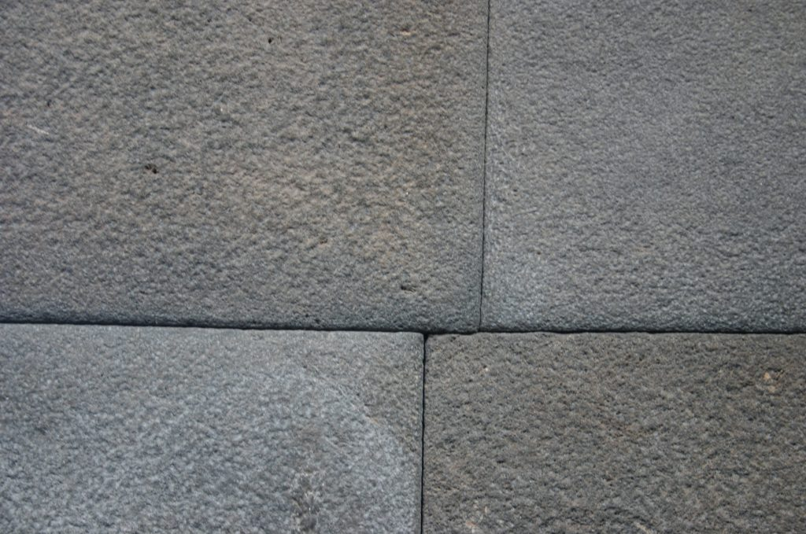

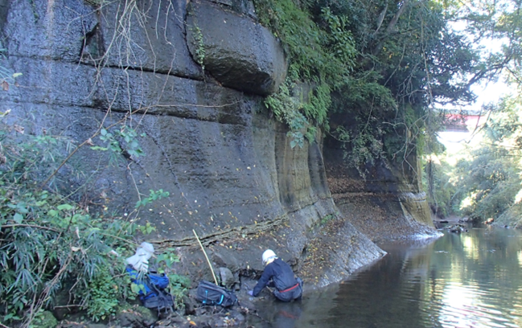
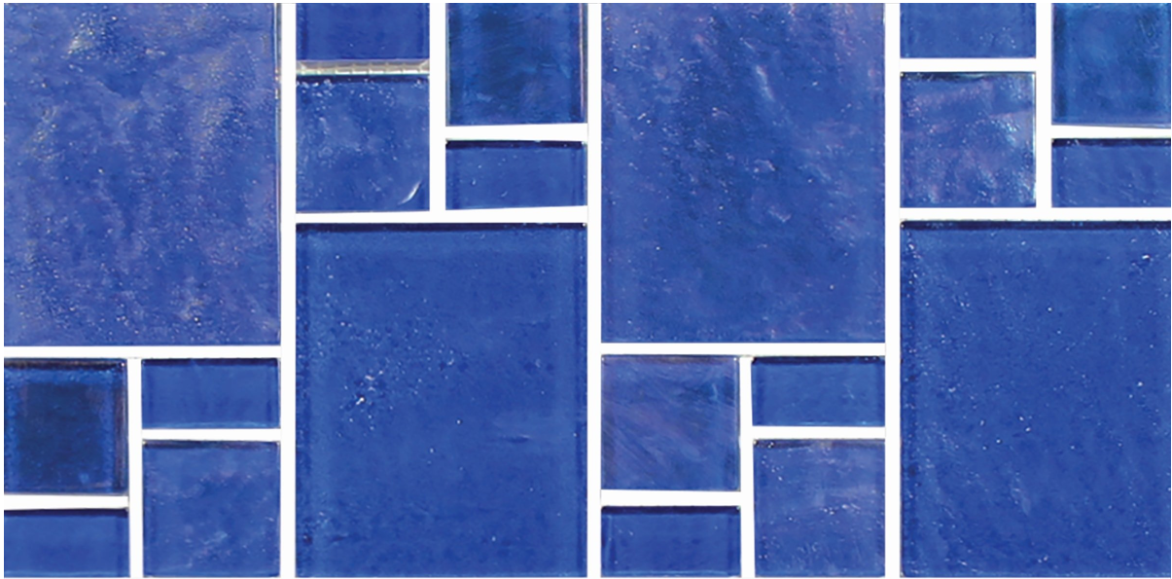

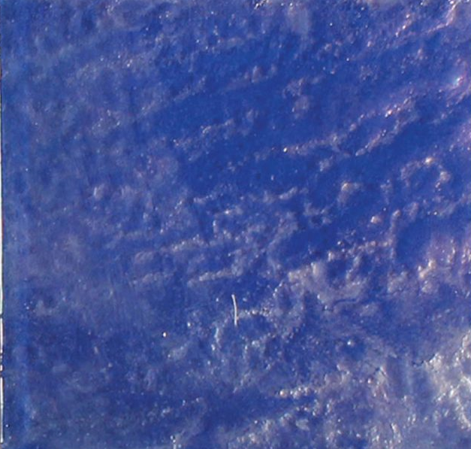
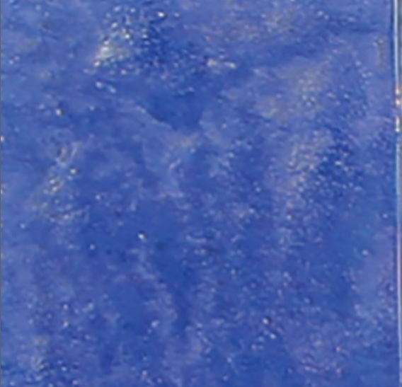
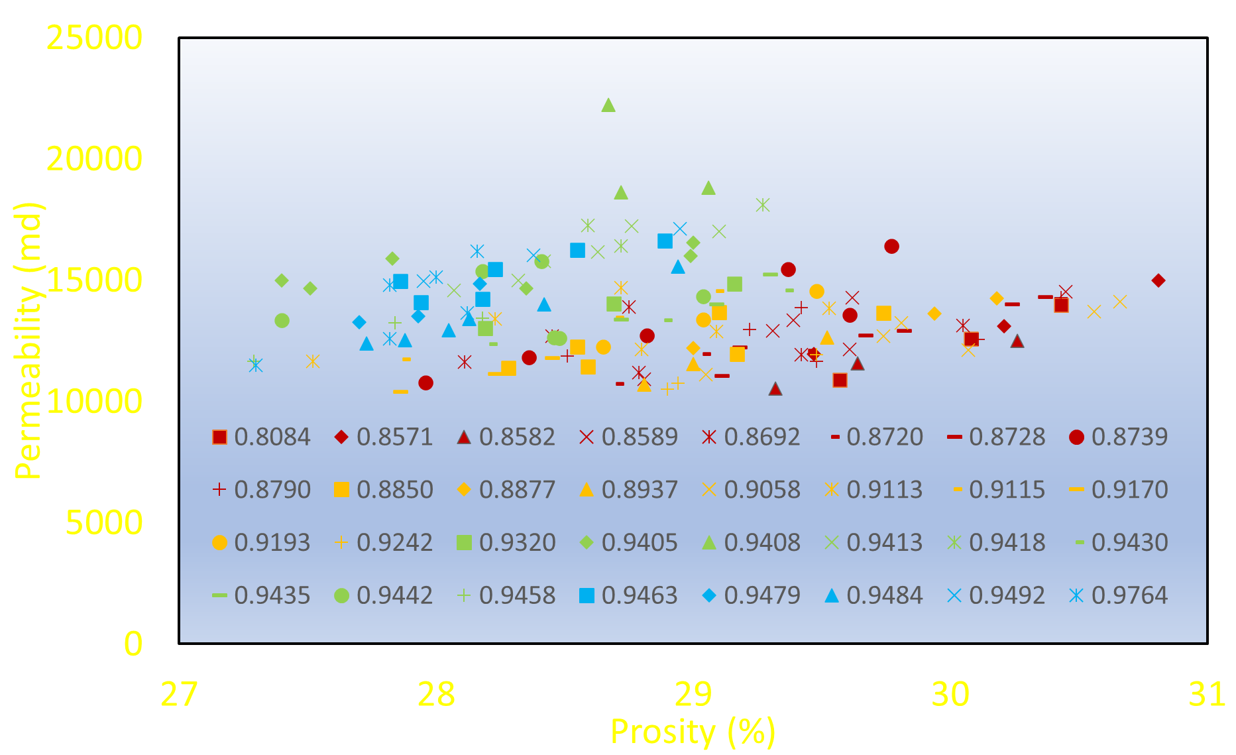
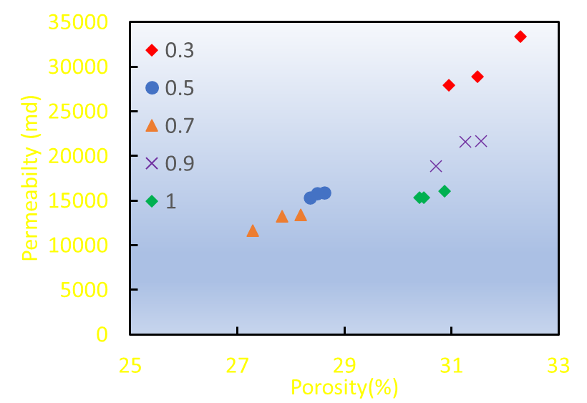
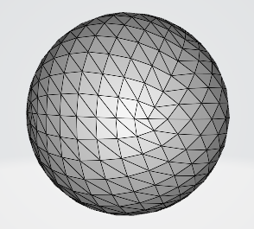
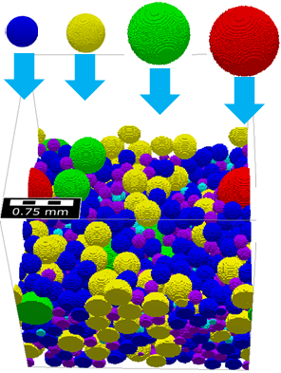
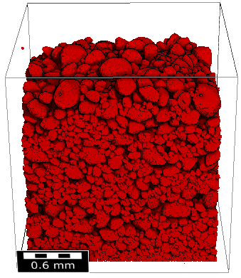
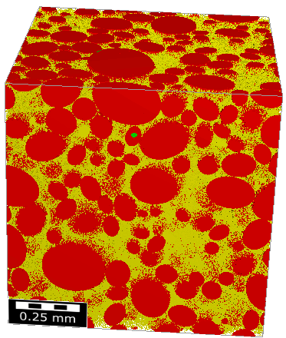
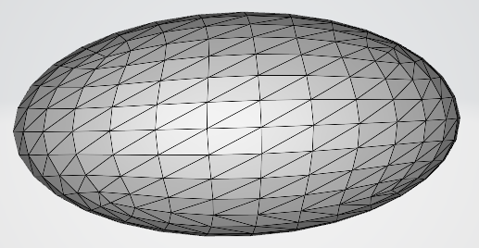
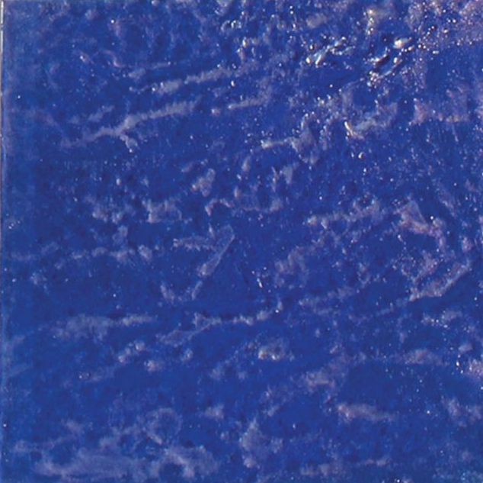
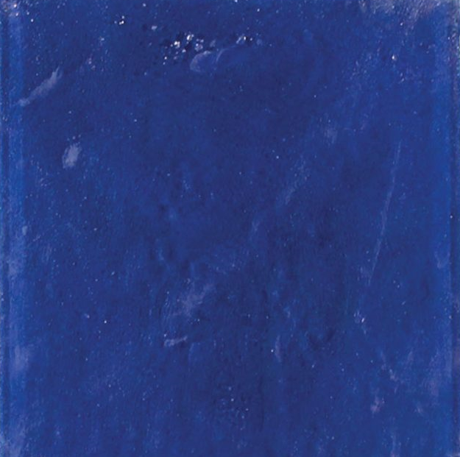
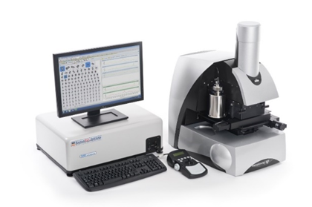
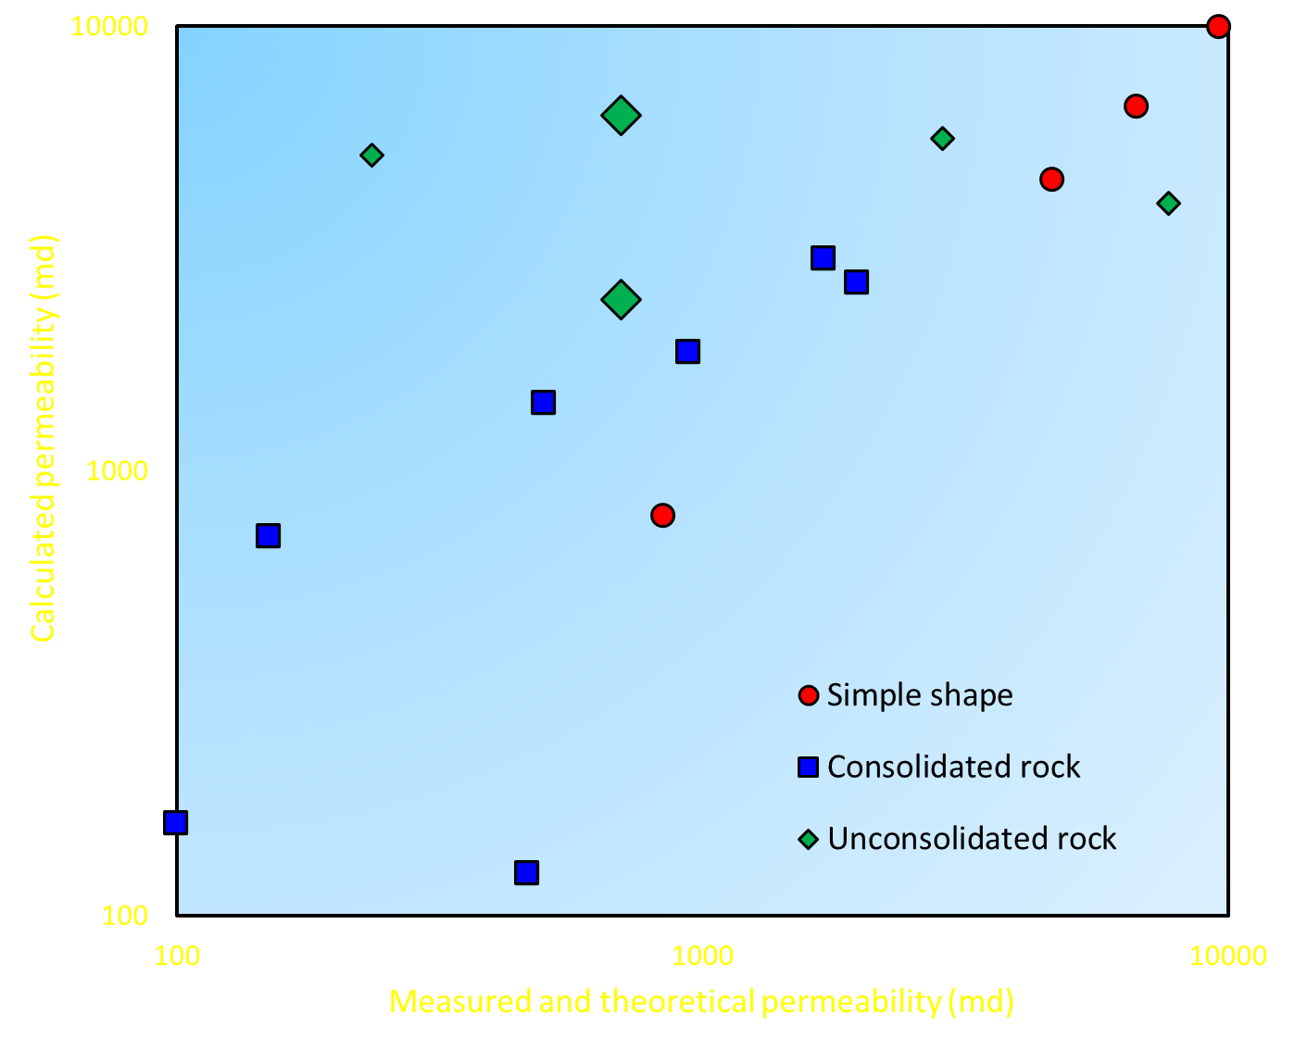
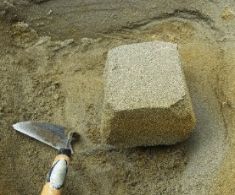
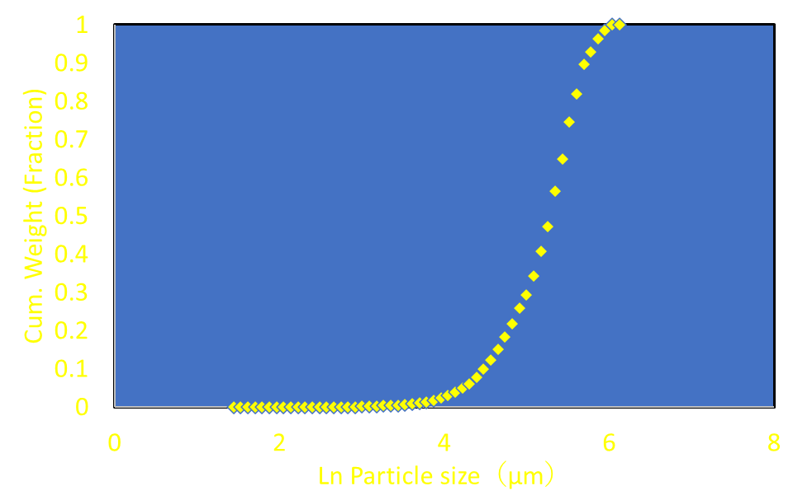
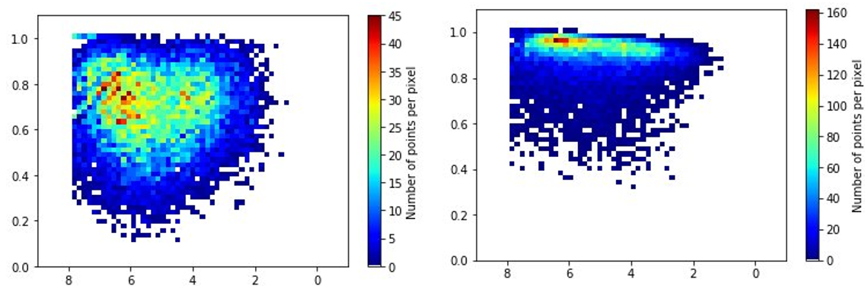

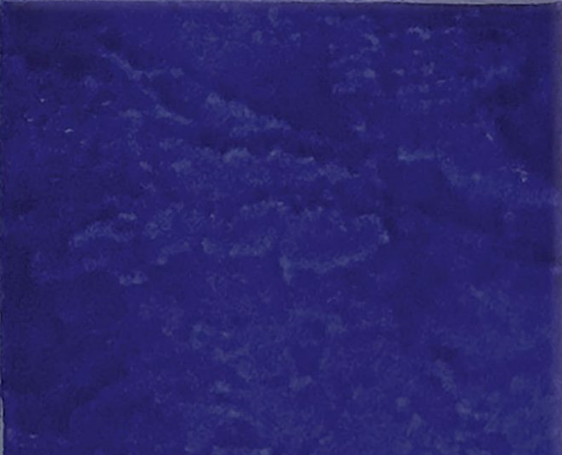
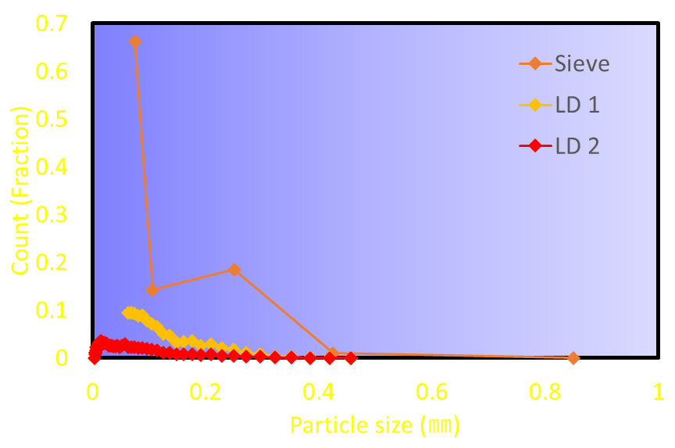
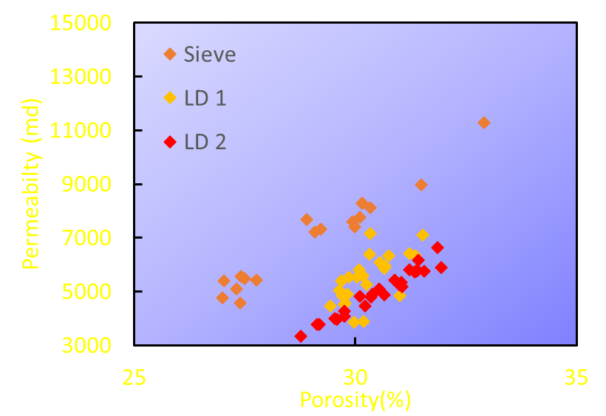
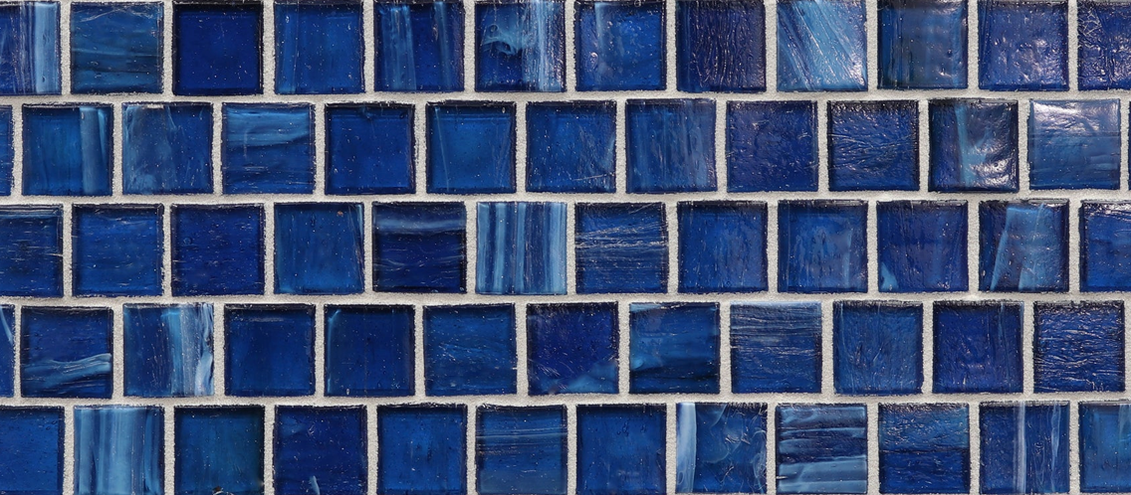
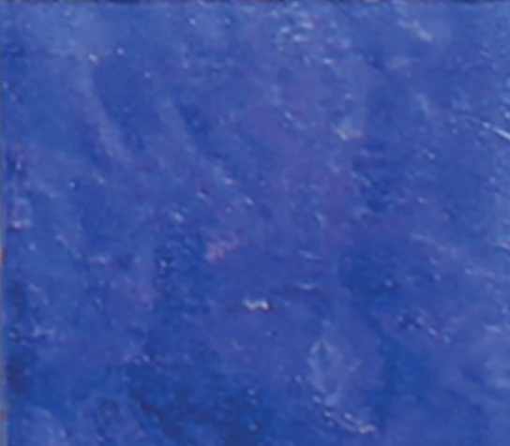
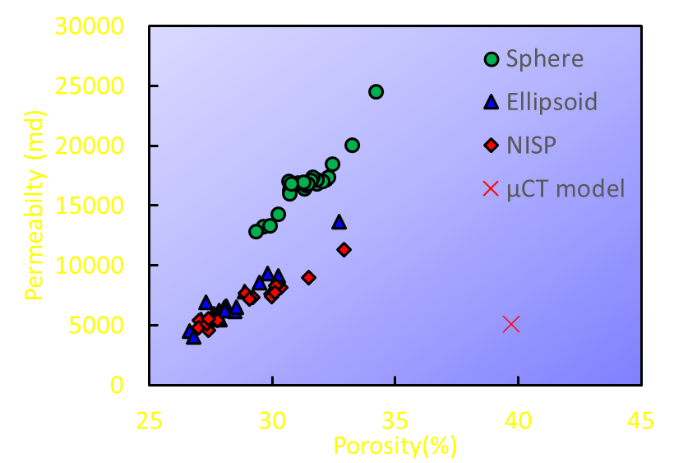
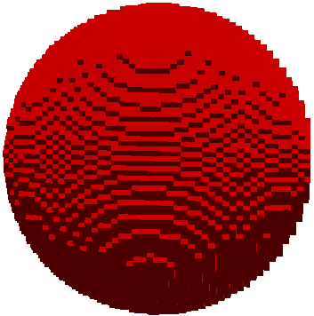
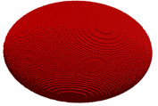


Impact of Particle Shape on Permeability in Unconsolidated Sandstone: Implication from Synthetic Models of Digital Rock Physics
Katsumo Takabayashi^{#1}
Yasutaka Iijima^{#2}
^{#1}INPEX CORPORATION, Reservoir & Production Group, Subsurface Development Unit, Technical Headquarters
^{#2}INPEX CORPORATION, CO2 Storage Group, Research Unit, Technical Division
Introduction
For effective carbon capture and storage (CCS), sufficient storage capacity and injectivity is crucial. Target reservoir depth of CCS in aquifers can be shallower than conventional E&P project in terms of economic efficiency. It infers that CCS projects have more chance to deal with unconsolidated rocks. Evaluating unconsolidated rocks is sometimes difficult, because there is uncertainty in acquisition of rock cores through drilling, which may result in lack of direct measurement of rock properties. To overcome this obstacle, we employed an indirect evaluation method called Digital Rock Physics (DRP) technology, which integrates the concept of "rock physics" to obtain rock properties from micro-level rock particles, and "digital core laboratory" to replace the conventional experimental method with numerical analysis with the development of X-ray CT equipment.
Object
Sensitivity study
By filling model particles, create DRP model (hereafter, synthetic DRP model) which reflect size distribution and shape of sand particle.
Evaluate the effect of particle shape on permeability with synthetic DRP model.
Predict permeability with synthetic DRP model to evaluate its applicability.
A sensitivity analysis was performed on the impact of aspect ration and circularity on the relationship between permeability and porosity.
Aspect ratio
Circularity
Methodology
15 ellipsoid models were created by changing aspect ratio from 0.3 to 1.0. It was found that the rate of increase in permeability to porosity was higher in case of lower aspect ratio.
144 NISP models were created by changing circularity from 0.81 to 0.98. It was found that the rate of increase in permeability to porosity was higher in case of lower circularity. However, this relationship was not as clear than that of the aspect ratio.
Assuming the situation to obtain physical properties of unconsolidated reservoir, disturbed sand particle sample obtained from outcrop were used to create synthetic DRP models. We created synthetic DRP models of the porous media simulating the reservoir rocks by packing objects that mimic sand particles. The model of particle reflects particle size distribution, in addition to circularity and aspect ratio which were selected as shape parameters. In this study, the software Particula, which is provided by Stanford University, were used to model particles for the “Influence of shape “and the “Sensitivity study” sections. The synthetic DRP model created with Particula was then imported to another software “GeoDict” to calculate physical property by using the finite volume method.
Finer particle size distribution models for the “Permeability Prediction” section was created by using GeoDict.
Aspect ratio
The model is created by freely dropping particles.
・Porosity 27 ~ 33%
・Results are qualitative
Circularity
$$\frac{4πA}{P^{2}}$$
Circularity
A: Particle projection area
P: Particle perimeter
Permeability and porosity
due to difference in Aspect ratio
Permeability and porosity due to difference in Circularity
L2
L1
$$\frac{L1}{L2}$$
Permeability Prediction
Aspect ratio
L1: Short axis
L2: Long axis
Image of synsetic DRP model
DRP model(Paticula)
DRP model(GeoDict)
Permeability was calculated by GeoDict, which can control the porosity of the synthetic DRP models.
By using high-resolution particle size distribution, synthetic DRP model with sphere and ellipsoid particle models were created to calculate the permeability. When compared to measured permeability, the calculated permeability with ellipsoid model shows good accuracy compared to the model with sphere model. The calculated permeability with ellipsoid model was within the similar error range compared to previous studies targeting consolidated sandstone.
As a result, a synthetic DRP model with high-resolution particle size distribution with ellipsoid model was successfully estimated the permeability of unconsolidated sandstone.
Measurements
By using outcrop sand sample, particle size distribution and particle shape were measured by using Morphologi, a particle shape measuring instrument. In order to compare effect of measurement tool for particle size, sand particle size distribution were also measured by dry sieving and laser diffraction analyzer. Synthetic DRP models were created based on measured data to calculate permeability.
By using block sample of the same outcrop, micro-CT image based DRP model were also created to compare calculated permeability from these different models.
Morphologi
Sphere
Aspect ratio
Circularity
Ellipsoid
Grain size (phi)
Grain size (phi)
Sandstone outcrop sample
Particle size distribution (PSD)
Aspect ratio | Circularity
0.7 | 0.92
Average particle shape
Influence of particle size distribution (PSD)
Comparision between the measured permeability and calculated permeability by DRP models
Three methods were compared to examine the impact of difference in measurement method for particle size distribution.
-Sieve :The measurement result by sieve method.
-LD1 : The measurement result by laser diffraction particle size analyzer which fine particles of 62 μm or less were ignored.
-LD2: The measurement result by laser diffraction particle size analyzer.
Results of comparison were as follows:
1.The permeability estimated with LD1 and LD2 were lower than that of Sieve.
2. Comparing LD1 and LD2, the permeability of LD1 show large variety than that of LD2, while both models showed almost same relationship between permeability and porosity.
From these results, high-resolution particle size distribution, which is obtained through laser diffraction particle size analyzer, is recommended as a input for synthetic DRP model.
Conclusions
The synthetic DRP model using ellipsoid model, which reflect aspect ratio of particle shape, was able to estimate the permeability better compared to a sphere model.
It is recommended to use high-resolution particle size distribution as an input data of the synthetic DRP model.
The sensitivity study confirmed the influence of aspect ratio and circularity on permeability.
The rate of increase in permeability to porosity was higher in case of lower aspect ratio
The increase of permeability to increase of porosity tended to slow down. However, the relationship was not as clear as the aspect ratio.
The synthetic DRP model using ellipsoid model and high-resolution particle size distribution was successfully estimated the permeability of unconsolidated sandstone
Reference
Particle size distribution used as input data of synthetic DRP model
土質試験の方法と解説 第6編 透水試験・圧密試験 第一回改訂版 社団法人 地盤工学会 平成１３年６月１５日訂正第4刷
Kohno, I., Nishigaki. M., 1982, Some aspects of laboratory permeability test, Soils and foundations. Vol.22, No.4 pp.181-190.
Blunt, M. J., 2017, MULTIPHASE FLOW IN PERMEABLE MEDIA. Cambridge University Press, pp. 500.
Bear, J., 1972, Dynamics of Fluids in Porous Media. Dover publications. pp. 757.
Core Laboratories, inc. 1973, A Course in the fundamentals of core analysis.
Saxena, N., Hows, A., Hofmann, R., Alpak, F. O., Freeman, J., Hunter, S., Appel, M., 2017, Imaging and computational considerations for image computed permeability: Operating envelope of Digital Rock Physics. Advances in Water Resources. 116, 127-144.
Hilfer, R., Lemmer, A., 2015, Differential porosimetry and permeametry for random porous media. Physical Review E, 92(1), 018805
Gresina, F., Farkas, B., Fabian, S. A., Szalai, Z., Varga, G., 2023, Morphological analysis of mineral grains from different sedimentary environments using automated static image analysis. Sedimentary Geology, 455, 106479.
Mitsunashi, T., Yamauchi, Y., 1988, Tectonic evolution of the sedimentary basin of the Kazusa Group, Kanto District, Japan, The memoirs of the geological society of Japan, 30, 67-75．
Andrä, H., Combaret, N., Dvorkin, J., Glatt, E., Han, J., Kabel, M., Keehm, Y., Krzikalla, F., Lee, M., Madonna, C., Marsh, M., Mukerji, T., Saenger, E. H., Sain, R., Saxena, N., Ricker, S., Wiegmann, A., Zhan, X., 2013 Digital rock physics benchmarks—part II: Computing effective properties. Computers & Geosciences. 50, 33-43.
Lander, R. H., Cook, J. E., Guilkey, J., Kerimov, A., Bonnell, L. M. and Goodwin, L. B., 2023, Digital rock advances from a material point method approach for simulation of frame moduli and a sedimentary petrology-inspired method for creation of synthetic samples through simulation of deposition and diagenesis. Geophysics, 89, Issue 1.
Small-Scale Reconsolidation Studies. Joint research report with GEOCOSM.
Feng G., Saman, A, A., 2019, An Experimental Investigation of Flow Regimes in Imbibition and Drainage Using a Microfluidic Platform. Energies, 2019, 12, 1390.
Al Ibrahim, M. A., Kerimov, A., Mukerji, T. and Mavko, G., 2018, Particula: A simulator tool for computational rock physics of granular media. Geophysics, 84, Issue 3.
Larry W. L., 1989, Enhanced Oil Recovery. Prentice-Hall, Inc.
Takahashi, T., Tanaka, S., 2013, Study on rock physical interpretation of geophysical data foe geotechnical applications (Part VII) – Estimation of permeability of soils and rocks with geophysical data-, Fukada geological institute annual report, No.14, p. 165- 172.
Jin, G., Patzek, T. W., and Silin, D. B., 2003, Physics-based reconstruction of sedimentary rocks. SPE 83587, presented at SPE Western Regional/AAPG Pacific Section Joint Meeting, Long Beach, California, USA.
Jin, G., Patzek, T. W., and Silin, D. B., 2004, Direct prediction of the absolute permeability of unconsolidated and consolidated reservoir rock. SPE 90084, presented at SPE Annual Technical Conference and Exhibition Meeting, Houston, Texas, USA.
Jin, G., Torres-Verdín, C., Radaelli, F., and Rossi, E., 2007, Experimental validation of pore-level calculations of static and dynamic petrophysical properties of clastic rocks. SPE 109547, presented at SPE Annual Technical Conference and Exhibition Meeting, Anaheim, California, USA.
Jin, G., Torres-Verdín, C., and Lan, C., 2009, Pore-level study of grain-shape effects on petrophysical properties of porous media. Paper TTT, presented at the SPWLA 50th Annual Logging Symposium held in The Woodlands, Texas, USA.
Jin, G., Lan, C., Kopal, M., Shao, W., and Chen, S., 2011, Predicting formation permeability from rock models constructed using log and/or geological data. Paper EE, presented at SPWLA 52nd Annual Logging Symposium held in Colorado Springs, Colorado, USA.
Jin, G., Manakov, A., Chen, J., and Zhang, J., 2012, Capillary pressure prediction from rock models reconstructed using well log data. SPE 159761, presented at the SPE Annual Technical Conference and Exhibition held in San Antonio, Texas, USA.
Jianghui, W., Guodong, J., Tom, B., Rex, S., Alberto, M., and Angelia, G., Enhancing Petrophysical Property Prediction from Well Logs Using Digital Rock Physics Technique - Case Study of a North Sea Sandstone Reservoir. SPE-177525-MS, presented at the Abu Dhabi International Petroleum Exhibition and Conference held in Abu Dhabi, UAE, 9–12 November 2015.
Carman, P. C., 1937, FLUID FLOW THROUGH GRANULAR BEDS. TRANS. INSTN CHEM. ENGRS, Vol. 15.
Permeability and porosity due to difference in PSD
Influence of shape
Three types of particles model were prepared to create synthetic DRP models: sphere, ellipsoid, and Nonspherical Irregularly Shaped Particles (NISP). All three models reflect the particle size distribution measured by the sieve method.
Results of comparison for three synthetic DRP models were as follows:
All synthetic DRP models tend to calculate higher permeability than the micro-CT image based DRP model.
Sphere model estimates higher permeability than other synthetic DRP models.
Ellipsoid and NISP models show similar permeabilities.
These comparisons suggests that the aspect ratio has the great impact on the permeability.
 | Sphere | Ellipsoid | NISP
Aspect ratio |  | ✓ | ✓
Circularity |  |  | ✓
Sphere
Ellipsoid
NISP
Permeability and porosity due to difference in Grain Shape
Grain Shape information for each particle models
Image of particle models

