Slide 1

  Experimental study of microbial hydrogen consumption rates by Oleidesulfovibrio alaskensis in porous media: Relevance for UHS
  By Raymond Mushabe:
  Na Liu, Nicole Dopffel, Geir Ersland, and Martin A. Fernø
  21st May 2025 (Interpore 2025)

Slide 2
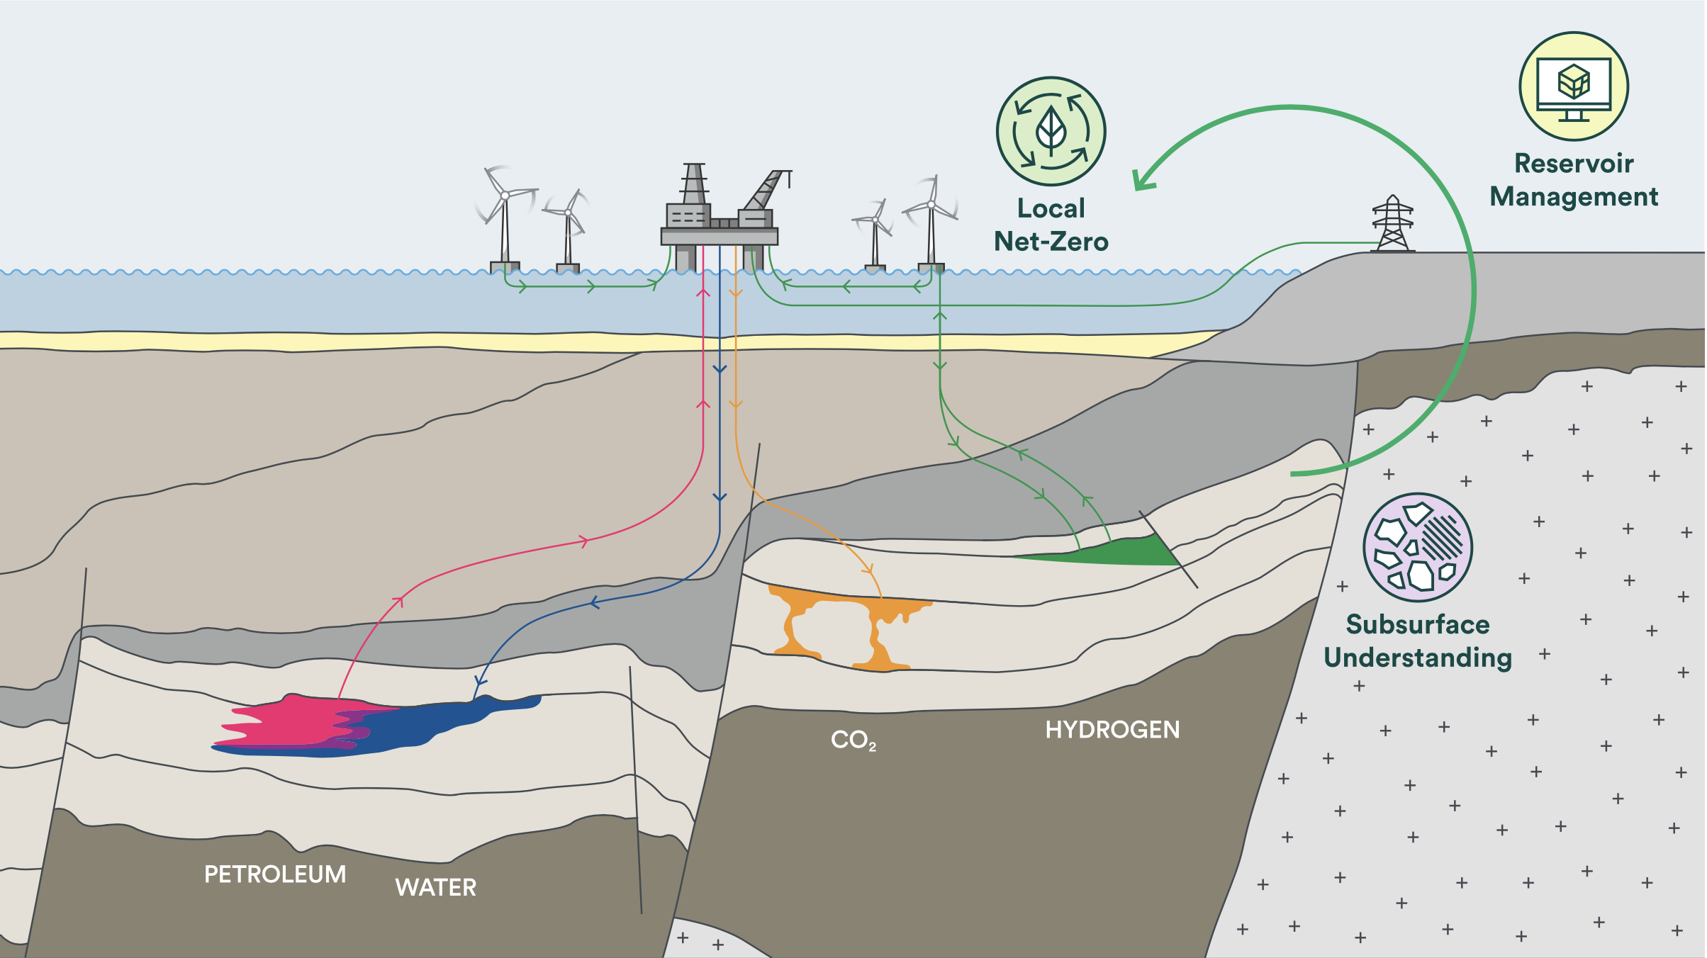
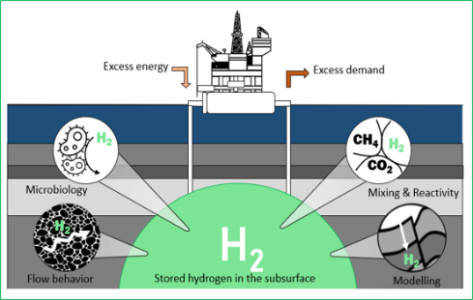



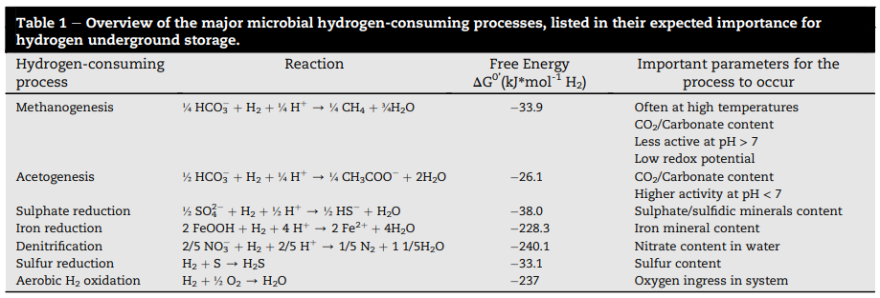

Scalable solutions for subsurface storage of hydrogen, air, and thermal
Energy storage in the subsurface
How can we explicitly measure hydrogen loss due to microbial activities in subsurface storage reservoirs for predictive storage and recovery efficiency???

Slide 3
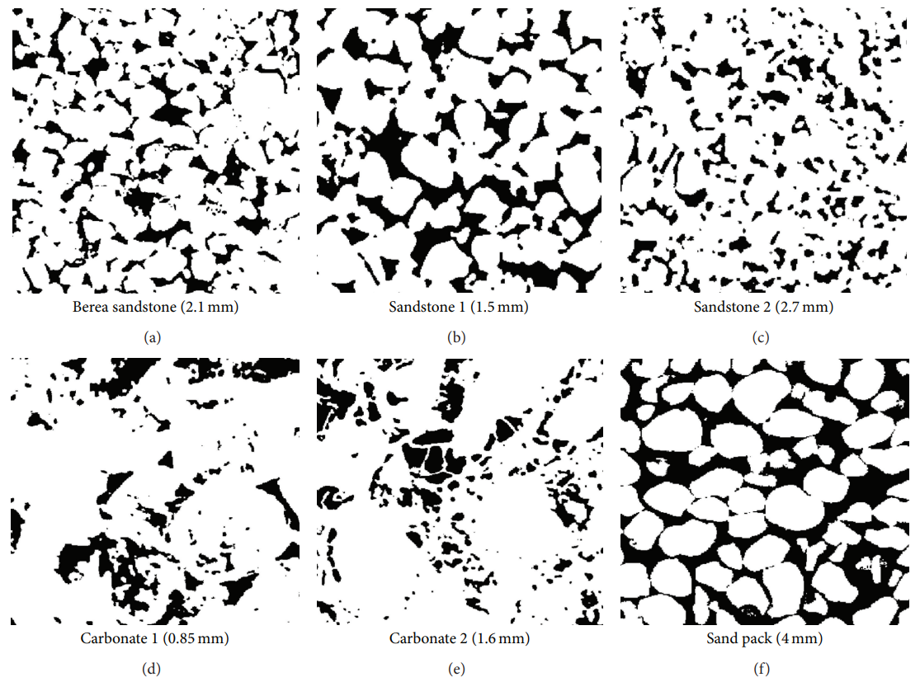
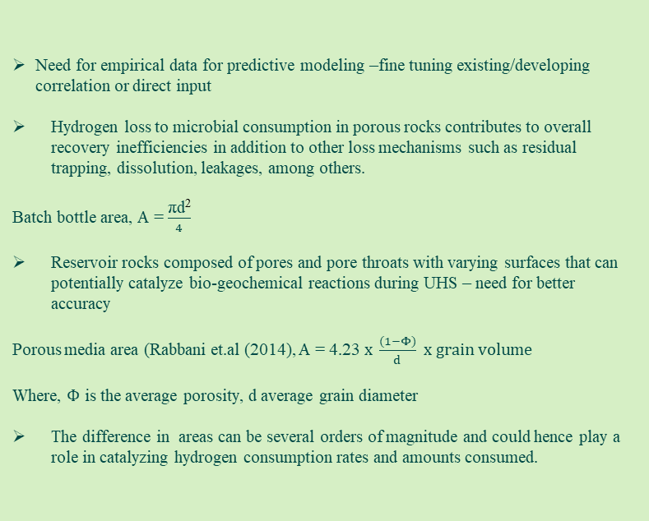
  Study motivation:
Porous media case
Need for empirical data for predictive modeling –fine tuning existing/developing correlation or direct input
Hydrogen loss to microbial consumption in porous rocks contributes to overall recovery inefficiencies in addition to other loss mechanisms such as residual trapping, dissolution, leakages, among others.
Batch bottle area, A = $\frac{\text{πd}\text{2}}{4}$
Reservoir rocks composed of pores and pore throats with varying surfaces that can potentially catalyze bio-geochemical reactions during UHS – need for better accuracy
Porous media area (Rabbani et.al (2014), A = 4.23$x \frac{(1−Φ)}{d} x grain volume$
Where, $Φ$ is the average porosity, d average grain diameter
The difference in areas can be several orders of magnitude and could hence play a role in catalyzing hydrogen consumption rates and amounts consumed.
Bottle case
H2
Brine
Illustration of a stationary batch bottle test
Micro CT images of rock samples from Rabbani et al. (2014) with grain size (a) 0.18 mm, (b) 0.35 mm, (c) 0.15 mm and (f) 0.25 mm,
Notes:
The goal is very broad, so we have worked to refine the scope into three key use cases

Slide 4
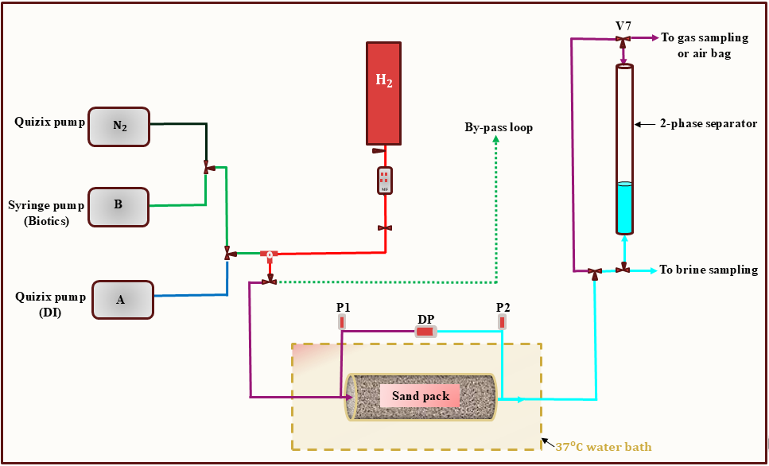
  Methodology: Sand pack study
Sand Pack ID | Test type | Grain size | Porosity | K, (Darcy) | SSA, [ mm-1 ]
SSF | Sterile | 0.25 mm (fine) | 0.3 | 1.2 | 3
SSM | Sterile | 0.5 mm (medium) | 0.3 | 1.3 | 6
SSC | Sterile | 1 mm (coarse) | 0.3 | 2.7 | 12
Sand Pack ID | Test type | Grain size | Porosity | K, (Darcy) | SSA, [ mm-1 ]
BSF | Bacterial | 0.25 mm (fine) | 0.3 | 1.5 | 3
BSM | Bacterial | 0.5 mm (medium) | 0.3 | 2.8 | 6
BSC | Bacterial | 1 mm (coarse) | 0.3 | 3.0 | 12
Anerobic environment (for Oleidesulfovibrio Alaskennsis G20 cells)
Multiple drainage ad storage cycles
Hydrogen amount calculated according to the ideal gas law, PV =nRT
Obtained rates normalised to hydrogen volume for comparison across sand packs and cycles, according Boyle’s law.
Initial pressure (1.15 - 1.45 bara) and 37C
Notes:
The goal is very broad, so we have worked to refine the scope into three key use cases

Slide 5
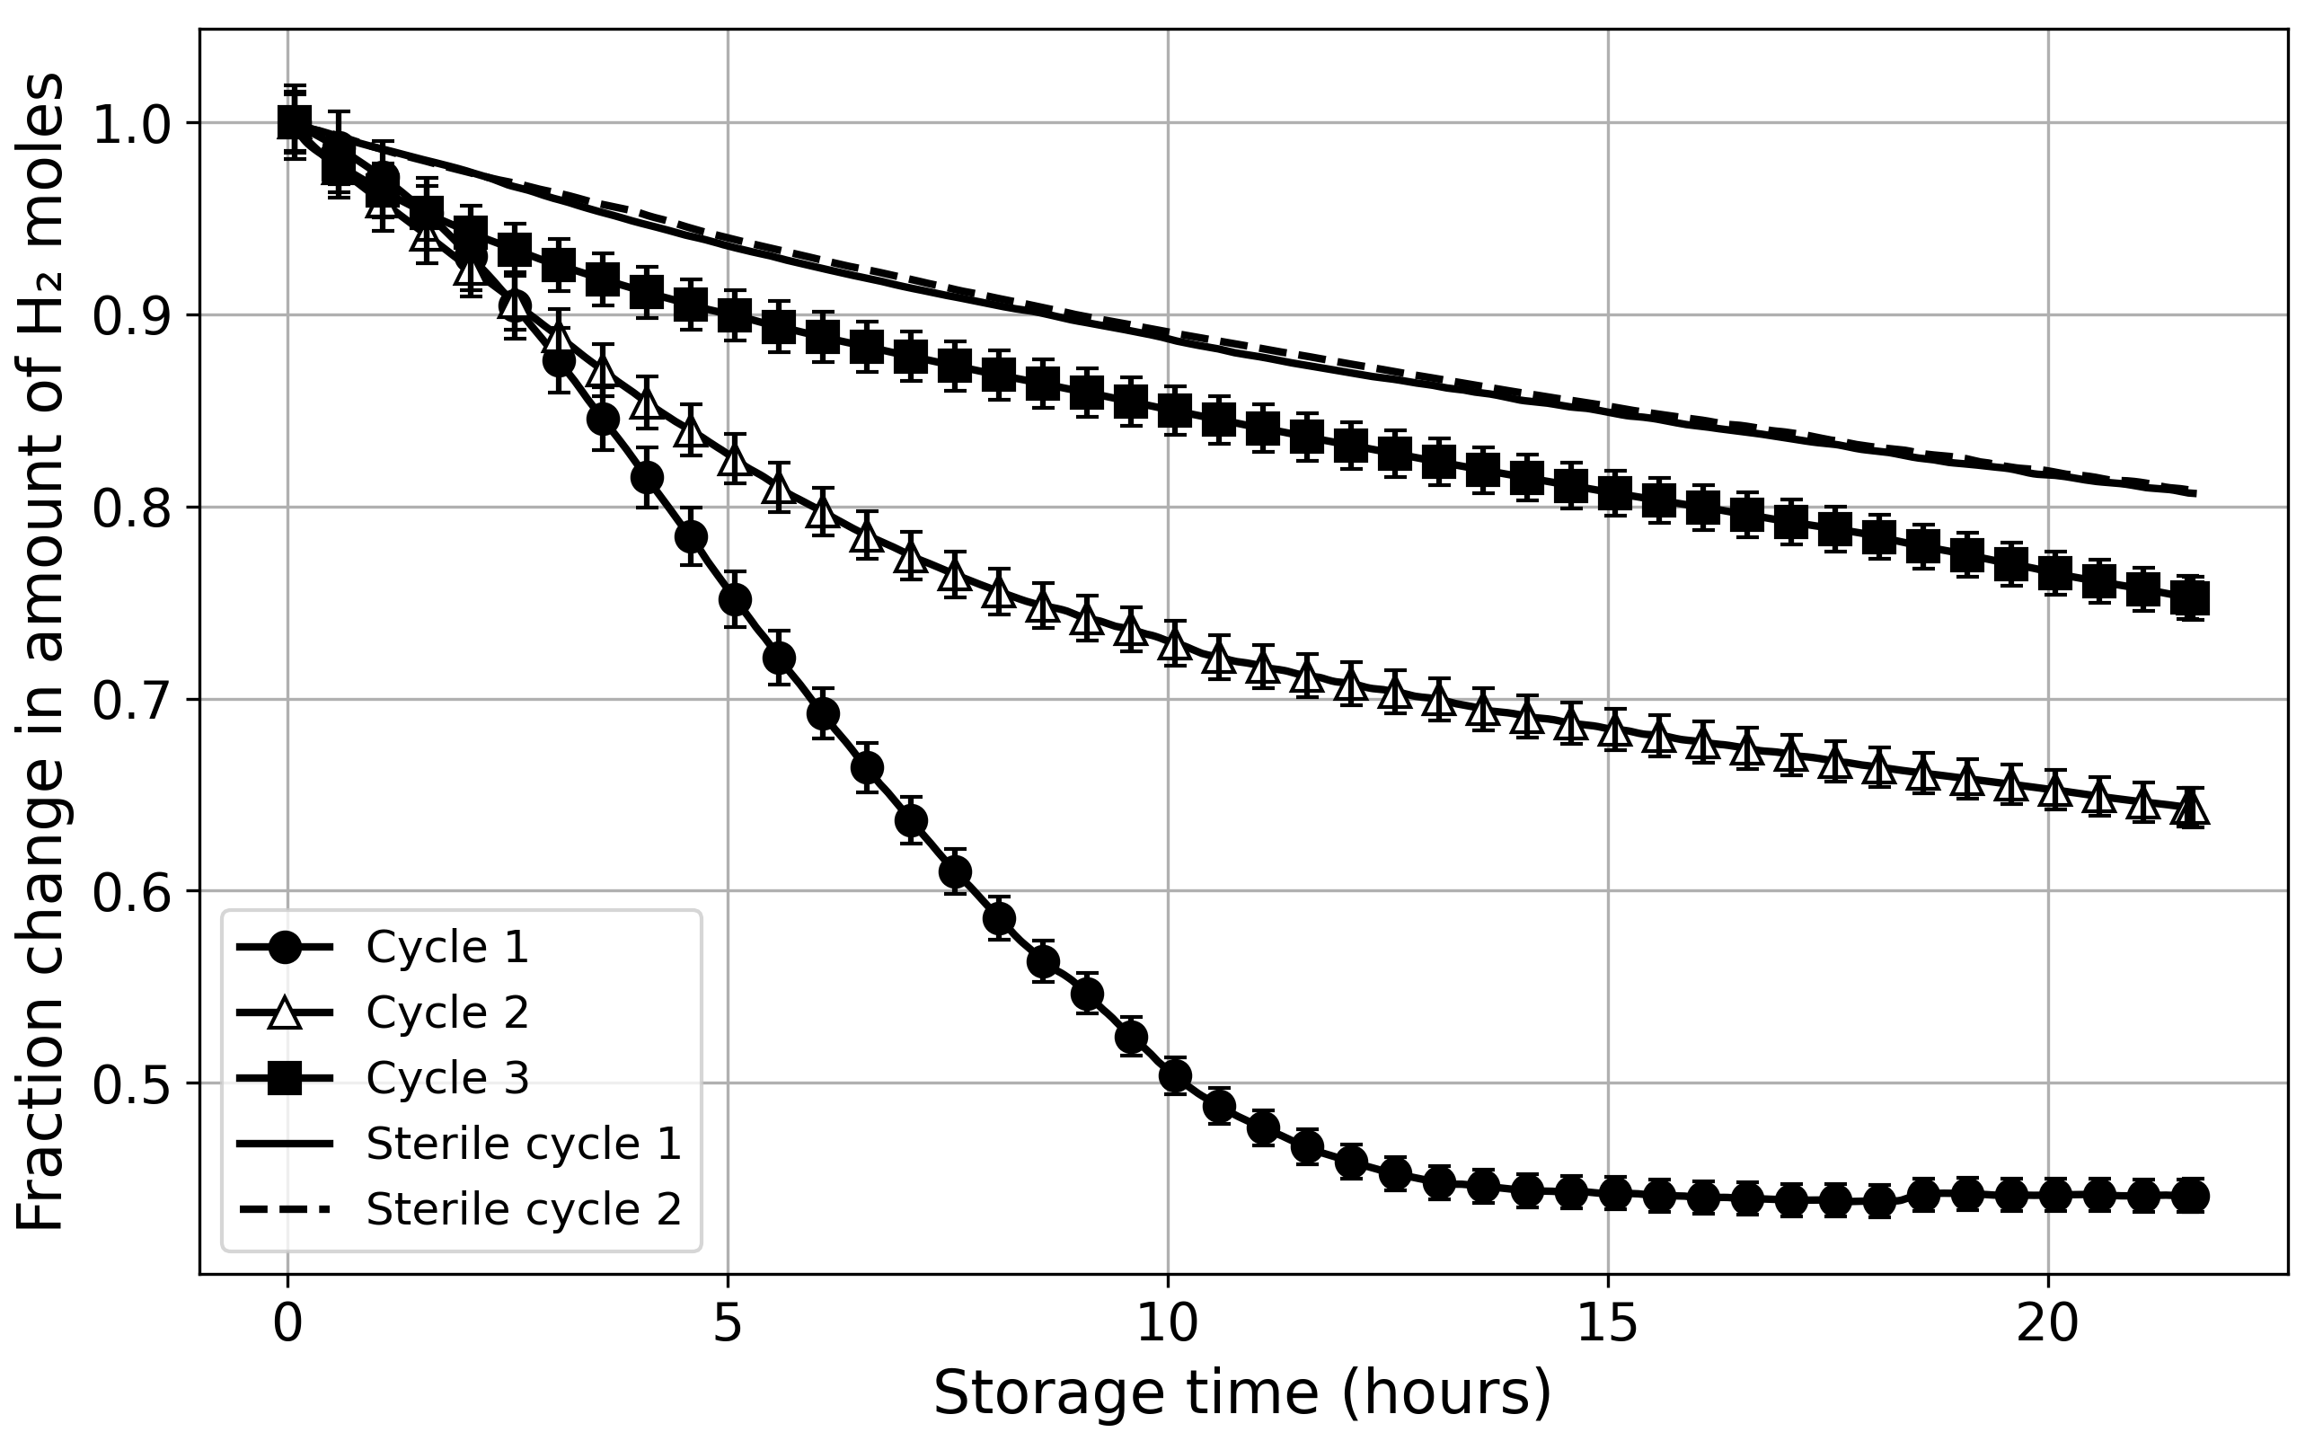
  Results: Hydrogen loss profiles
Basing on the general relative trend, consumption highest in the first storage cycle and decreased with cycle number.
Decline in the sterile case due to mechanical losses
  Predominantly dissolution at the two-phase interfaces and diffusion in the bulk water phase
Hydrogen losses in the later cycles of the non-sterile packs were comparable to the sterile cycles
Reported uncertainity due to small temperature (±1ºC) and pressure (±5 mbar).
Strile cycles
Relative $H_{2}$ mole change in storage cycles for one of the sand packs. The normalisation was against the starting moles in each storage cycle.
Notes:
The goal is very broad, so we have worked to refine the scope into three key use cases

Slide 6
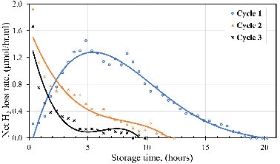
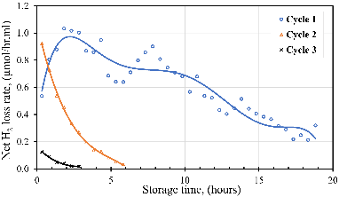
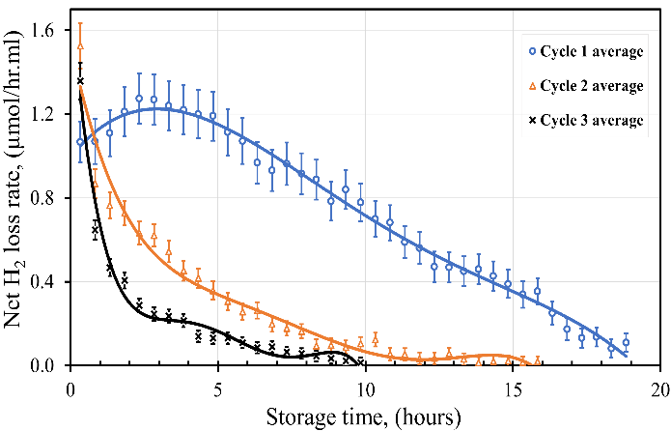
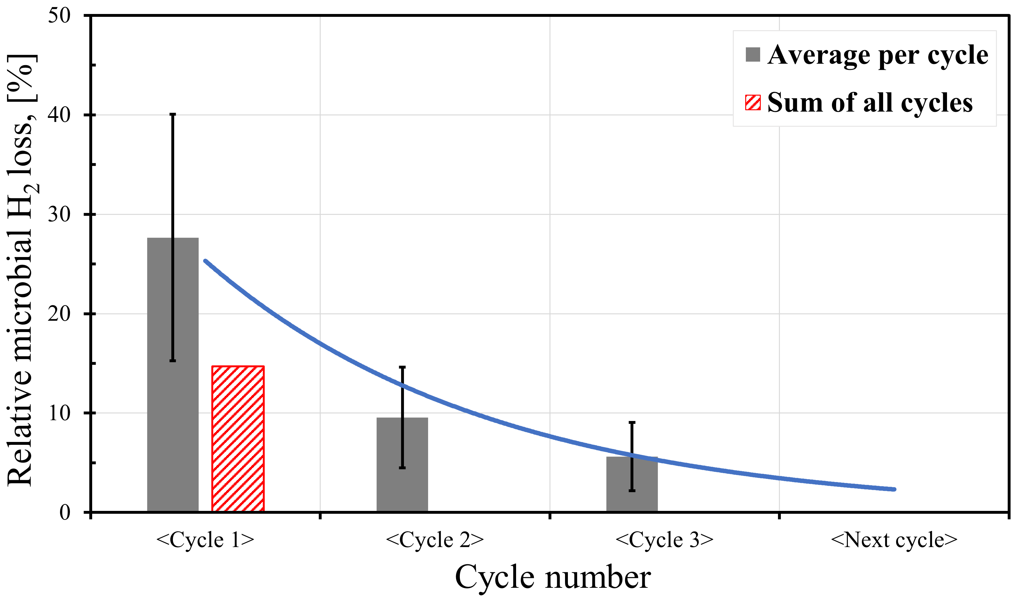
  Results: Derived consumption rates
10 repetitions with one sand size. All rates ranged within the same order of magnitude.
Deducted hydrogen loss associated with sterile cycles to obtain net microbial hydrogen loss rates
Rates declined with storage time in a cycle with a relative loss of 15 ± 6% in all cycles at the experimental conditions
Sulphate and acetate were not limiting.
Signifcant increase in brine pH to 8.3 ± 0.2
Notes:
The goal is very broad, so we have worked to refine the scope into three key use cases

Slide 7
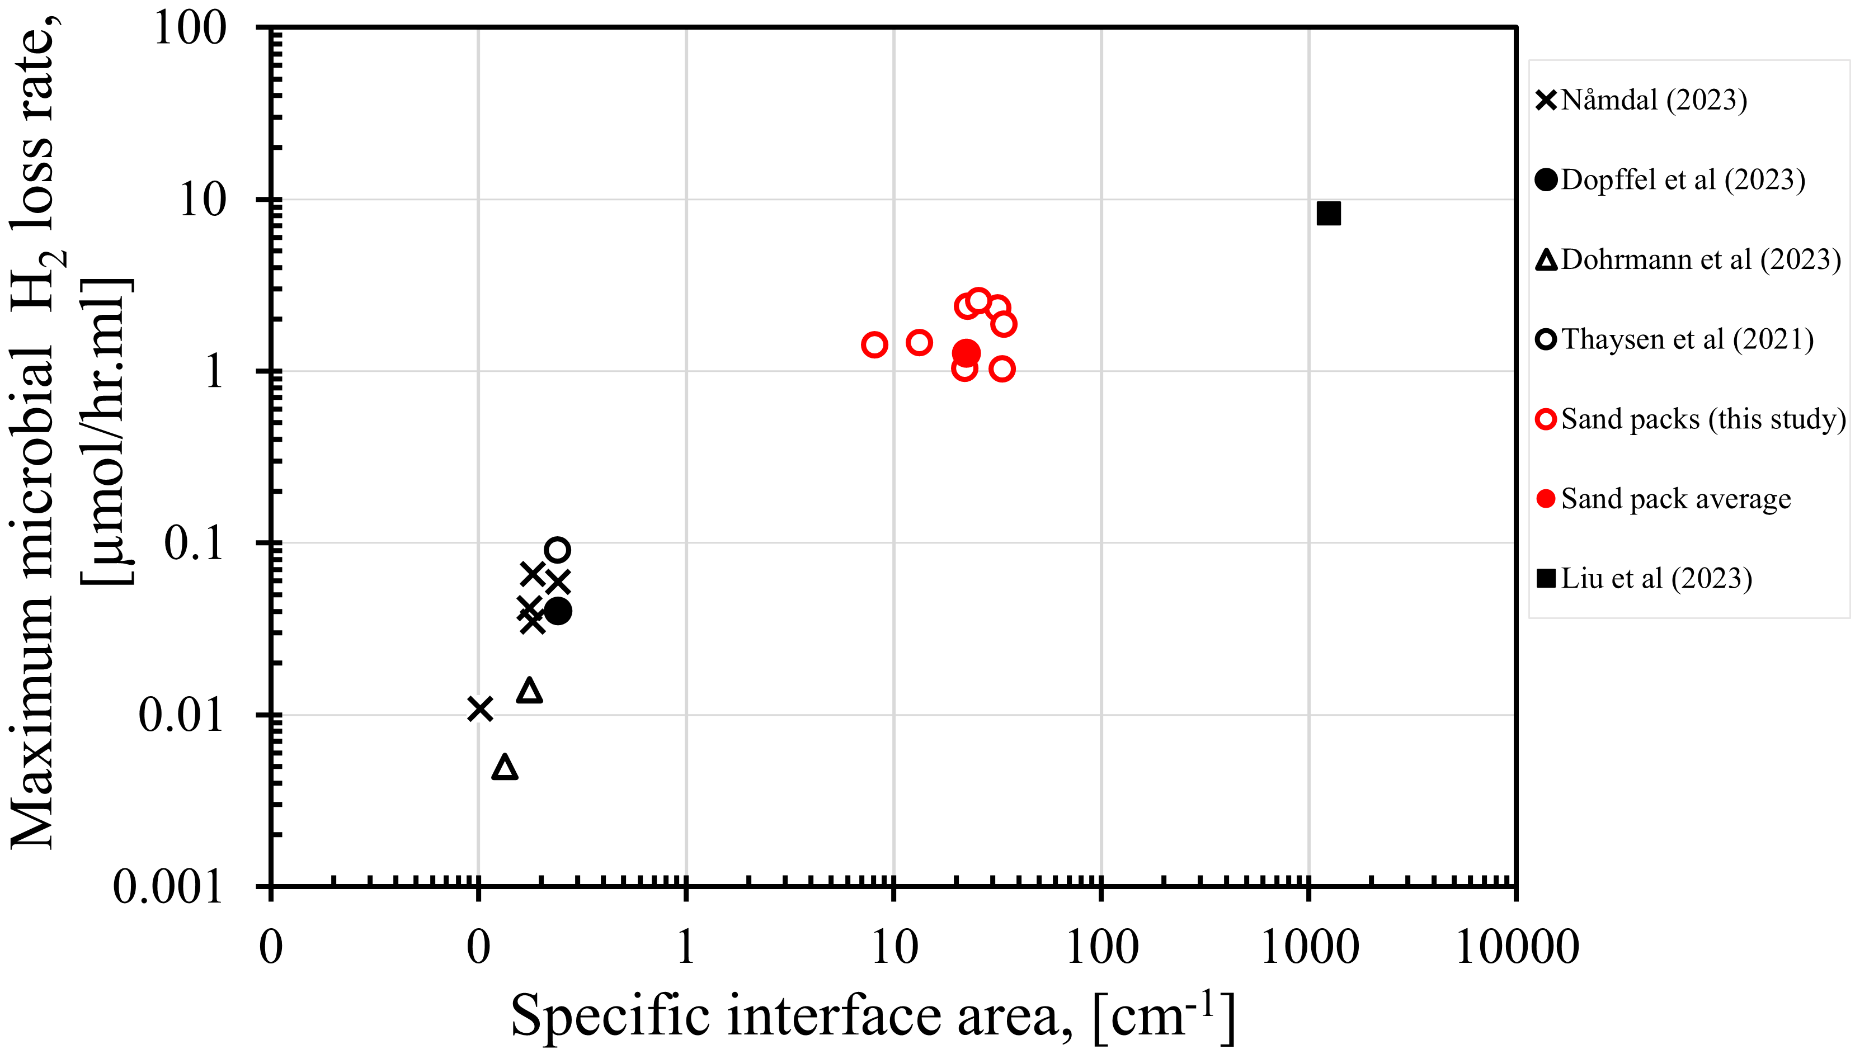
  Results: Comparison with batch tests
Consumption rates in sand packs (porous media) were 1-2 orders of magnitude higher than in batch bottle tests . Though shorter consumption intervals
Variation attributed to hydrogen dissolution rates – higher in porous media
This prompted the second phase of the study that explored the impact of specific surface area on consumption rates.
Comparison of our experimental results with reported literature data.
Notes:
The goal is very broad, so we have worked to refine the scope into three key use cases

Slide 8
  Surface area impact
Sand Pack ID | Test type | Grain size | Porosity | K, (Darcy) | SSA, [ mm-1 ]
SSF | Sterile | 0.25 mm (fine) | 0.3 | 1.2 | 3
SSM | Sterile | 0.5 mm (medium) | 0.3 | 1.3 | 6
SSC | Sterile | 1 mm (coarse) | 0.3 | 2.7 | 12
Sand Pack ID | Test type | Grain size | Porosity | K, (Darcy) | SSA, [ mm-1 ]
BSF x3 | Bacterial | 0.25 mm (fine) | 0.3 | 1.5 | 3
BSM x3 | Bacterial | 0.5 mm (medium) | 0.3 | 2.8 | 6
BSC x3 | Bacterial | 1 mm (coarse) | 0.3 | 3.0 | 12
Three specific surface areas
One drainage cycle
Two to three storage cycles (based on the pressure drop magnitude)
PV = 13 mL, P = 1.45 bara
Notes:
The goal is very broad, so we have worked to refine the scope into three key use cases

Slide 9
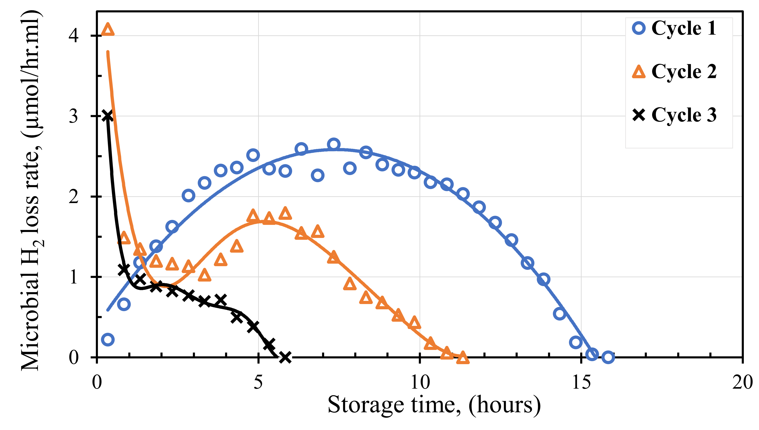
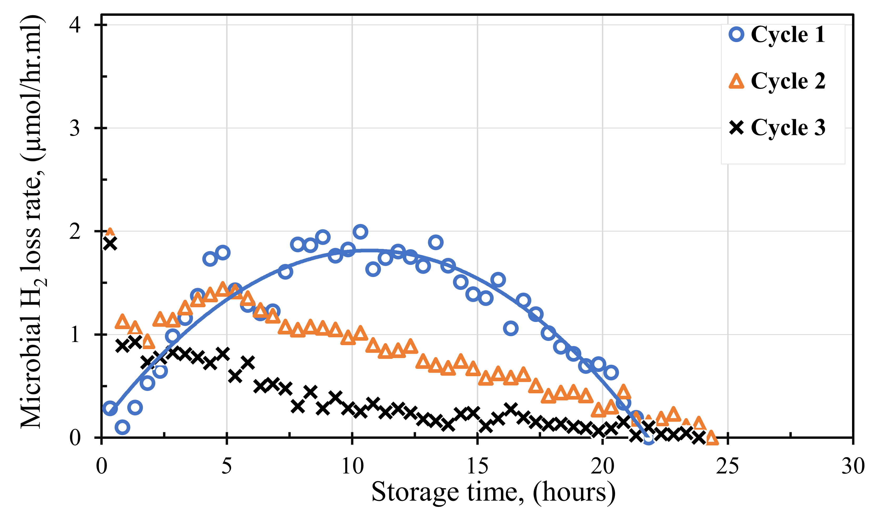
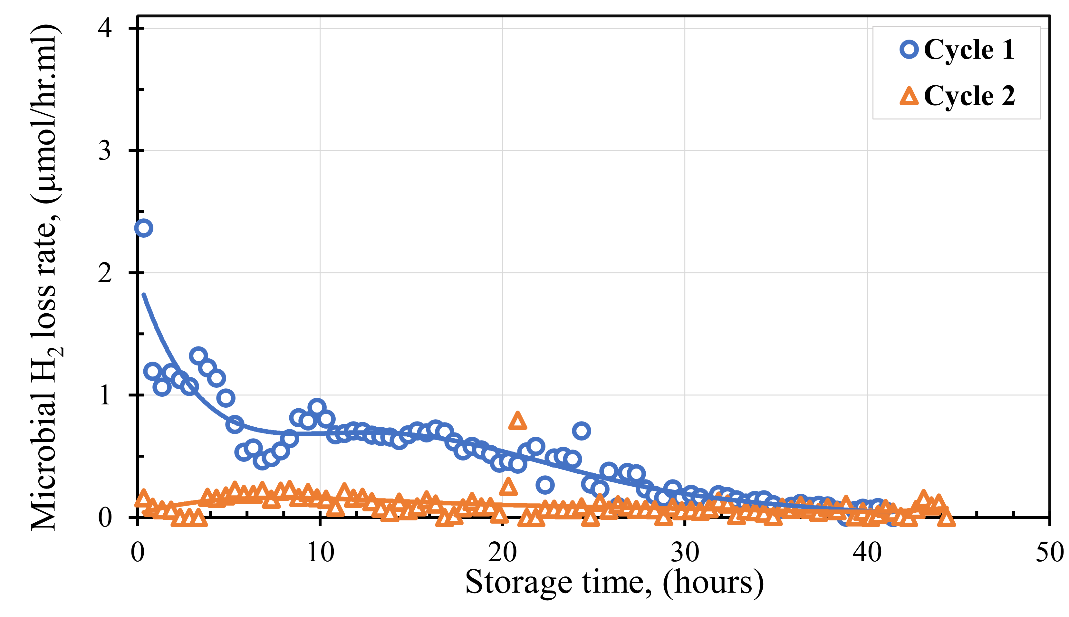
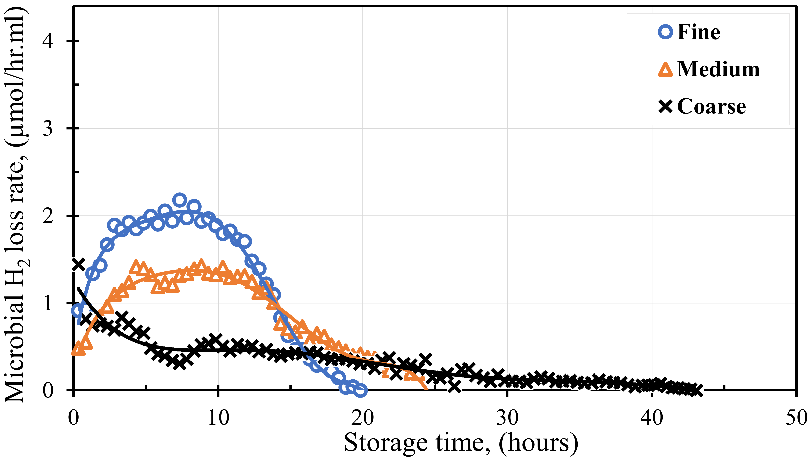
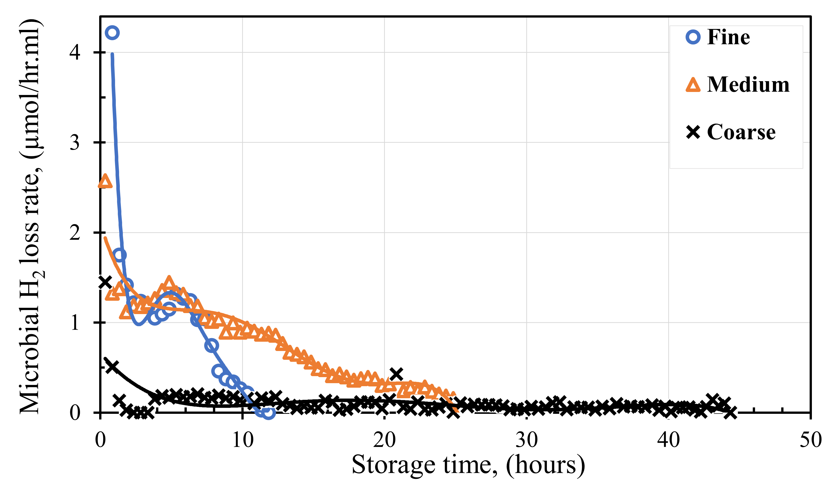
  Results: Consumption rates in bacterial tests
Fine-grained
Medium-grained
Coarse-grained
Key findings
Microbial hydrogen consumption rates varied both with SSA and storage cycle number over a 96-hour storage period
The rates were generally most dominant in the first storage cycles.
Microbial hydrogen consumption rates were highest in fine-grained sand packs
  Consistent with the dissolution rates (in sterile cycles)
  But Shorter consumption intervals
Lowest consumption rates in coarse grained sand packs. However, consumption sustained longest activity
  Similar to batch bottle tests
Medium grained sand packs had the highest end pH of 8.5 - 8.6. Limiting zone for this strain.
Average storage Cycle 1
Average storage Cycle 2
Notes:
The goal is very broad, so we have worked to refine the scope into three key use cases

Slide 10
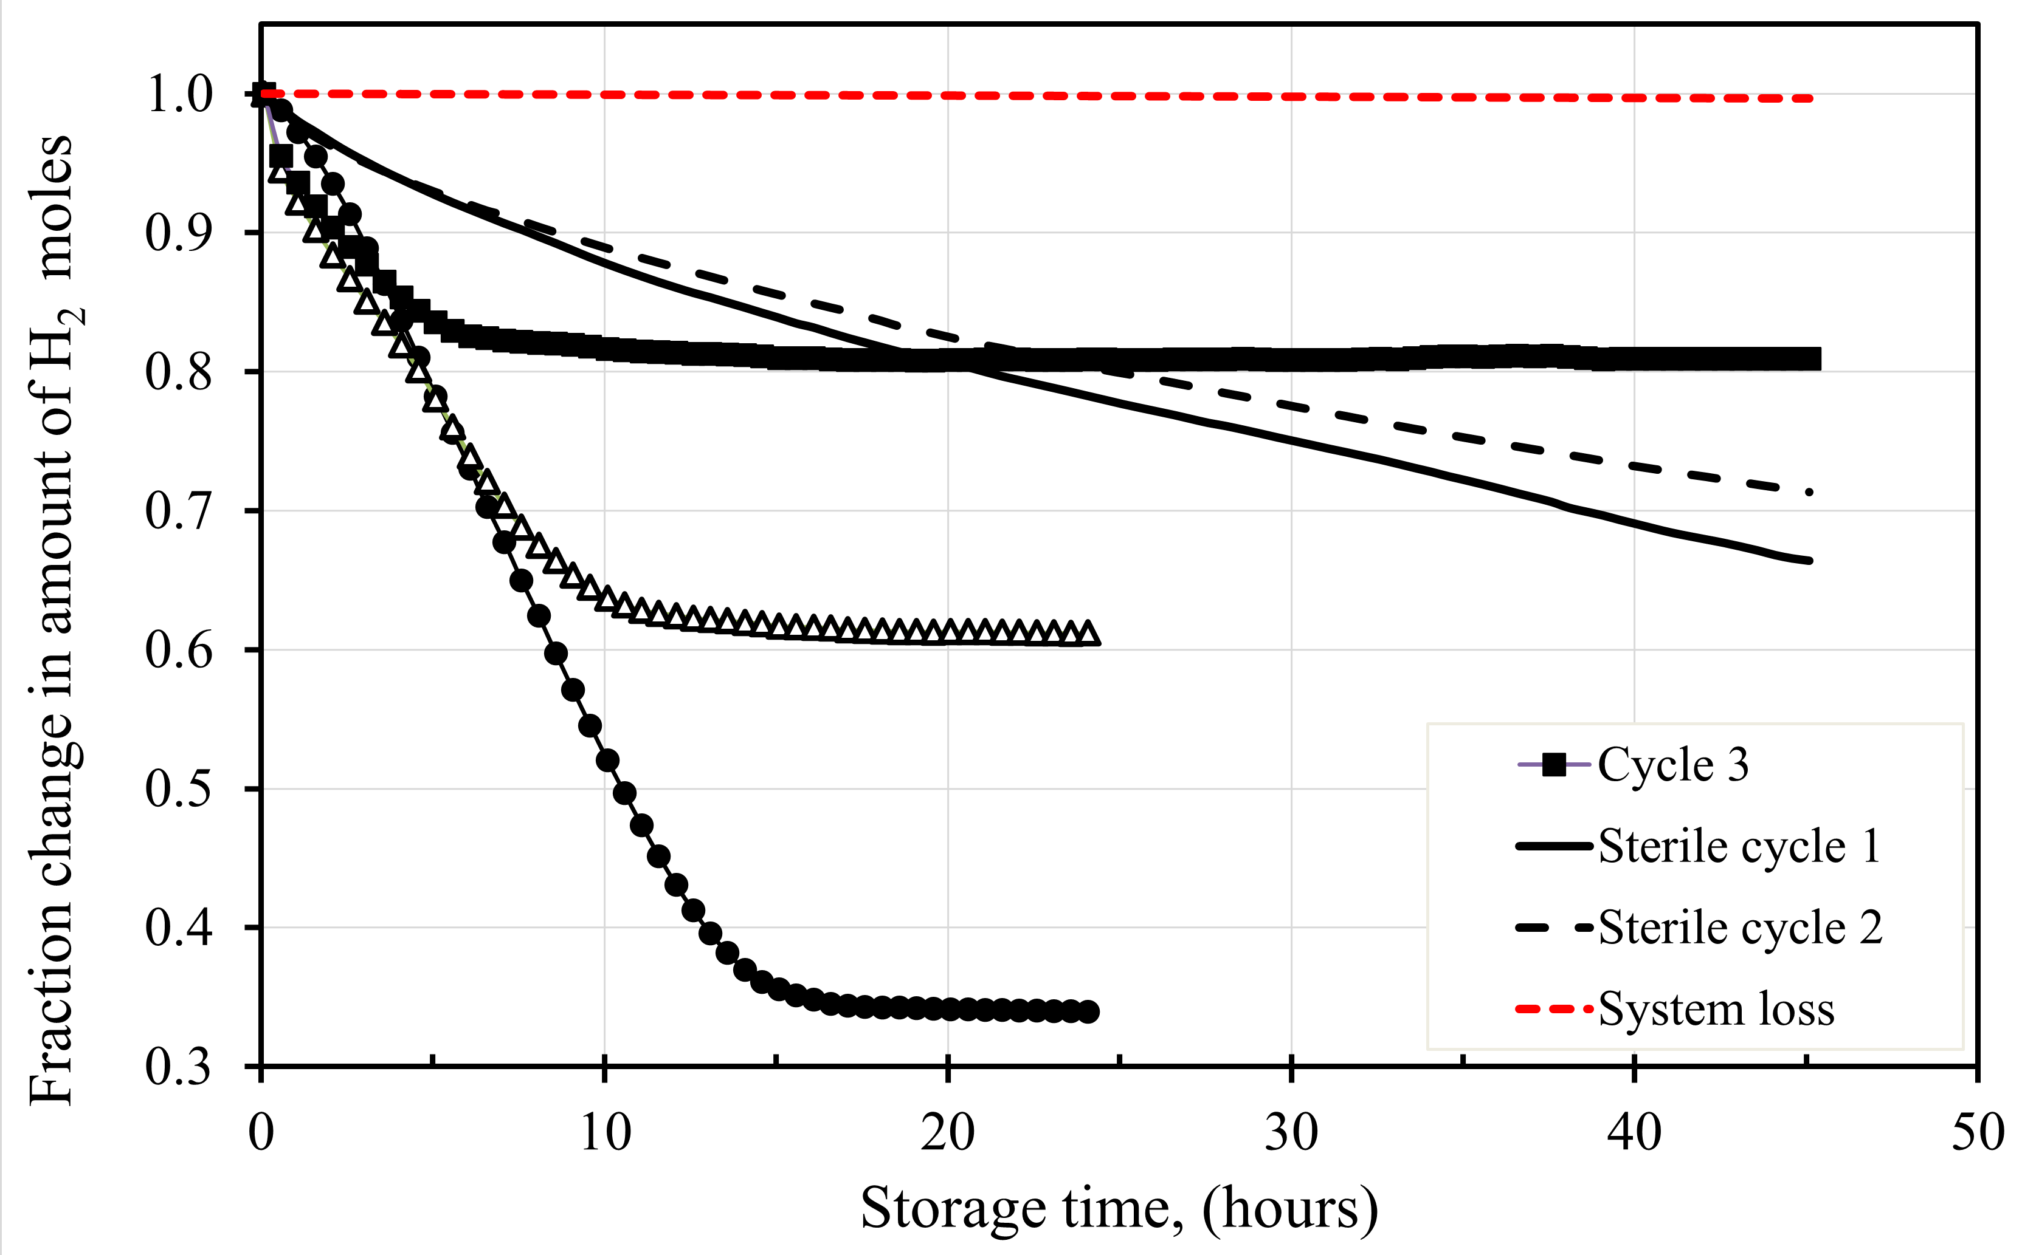

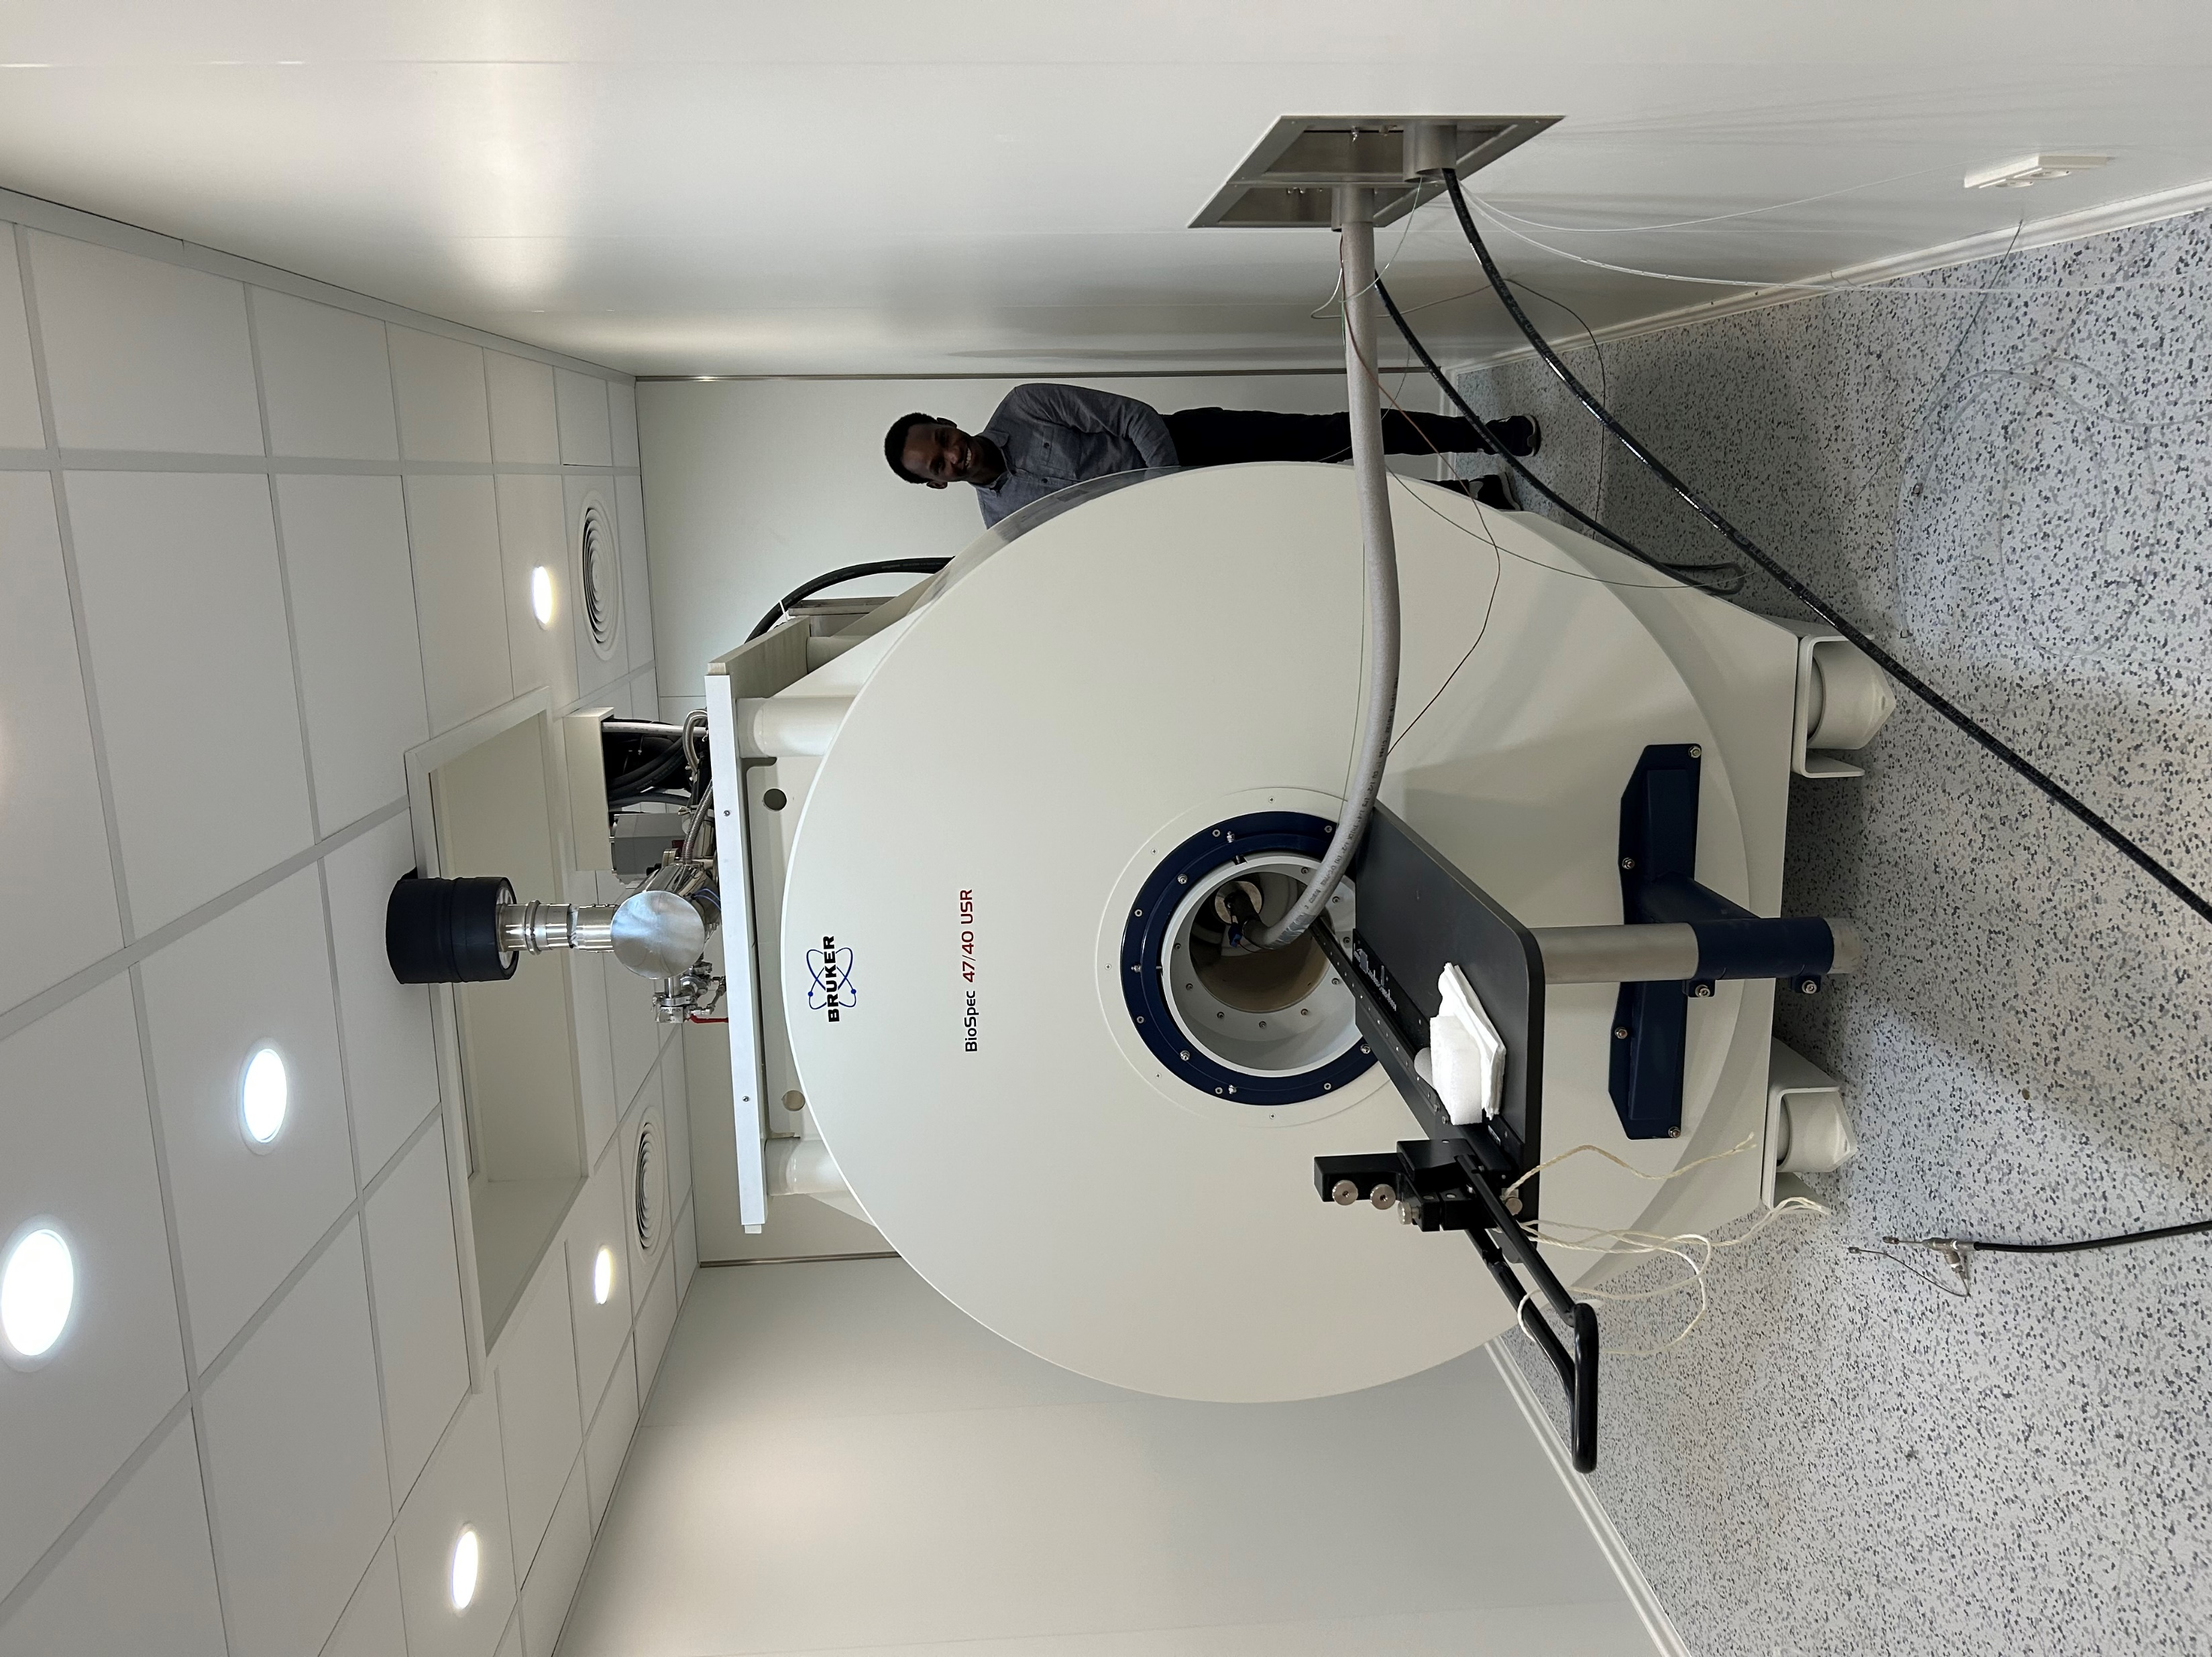

  Results: Additional findings.
Microbes were self-limiting with hydrogen consumption due change in pH
  Further consumption possible in fine and coarse. Implying change in local brine environment especially pH
Losses in the later stages of the fine, medium and coarse grained were lower than the mechanical losses (plateauing intervals)
Improvement in sand pack storage capacity (average Sw) between drainage cycles in non-sterile sand packs (4 – 24%)
  Recent MRI data will give insight into some of these phenomenon
3
2
1
Sw = 1
Used a 4.7 T MRI scanner to image hydrogen injection and storage cycles both in sterile and non-sterile cycles
Applied different imaging configureations (T1, T2, PD and combination of them) to understand different processes
Sw = 0.65
Notes:
The goal is very broad, so we have worked to refine the scope into three key use cases

Slide 11
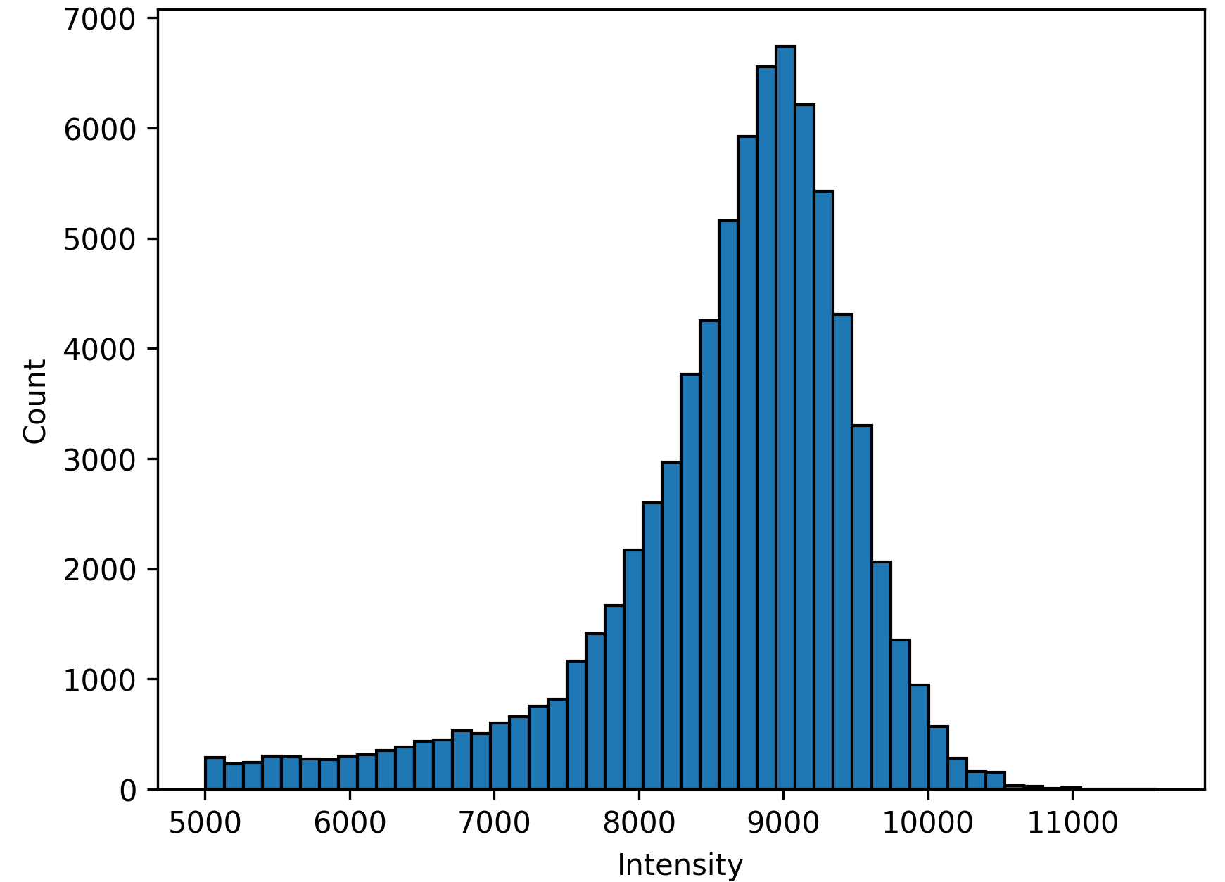
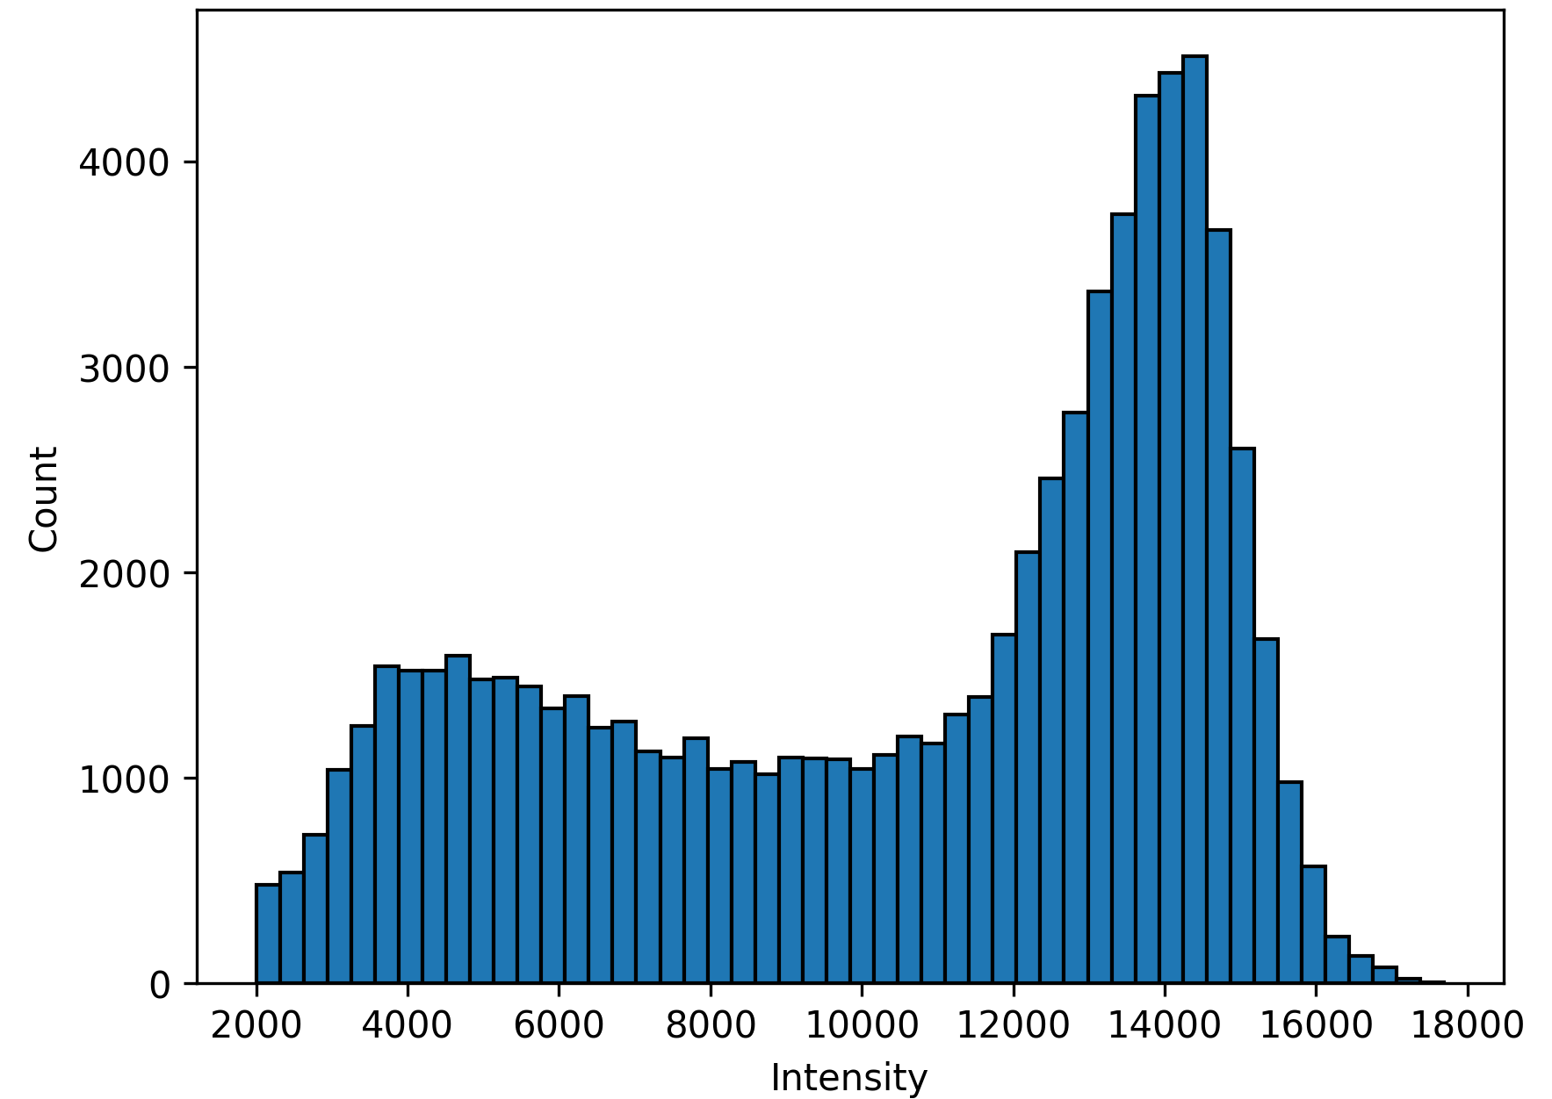
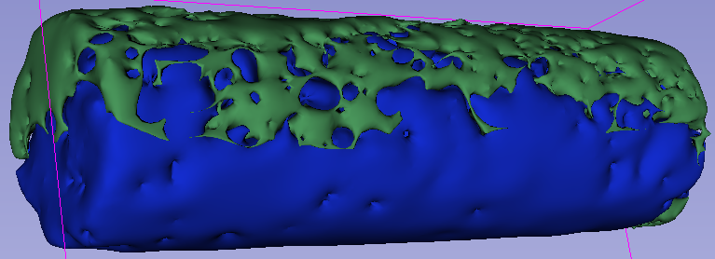
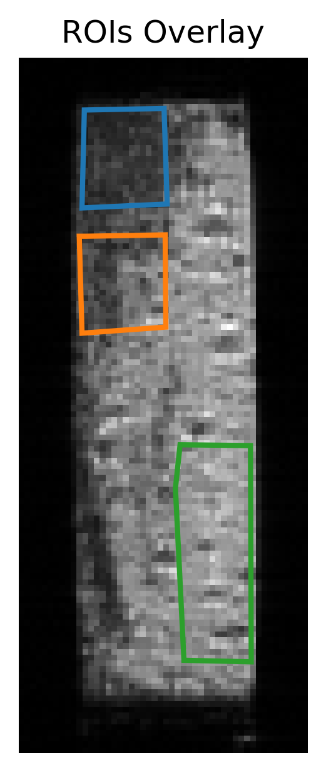
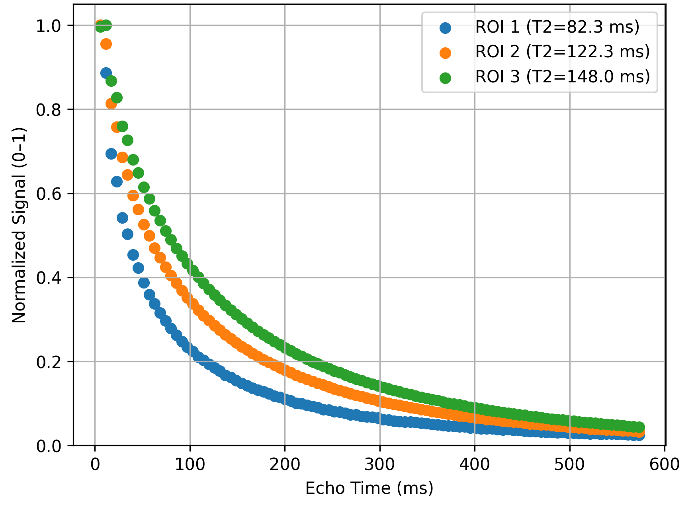
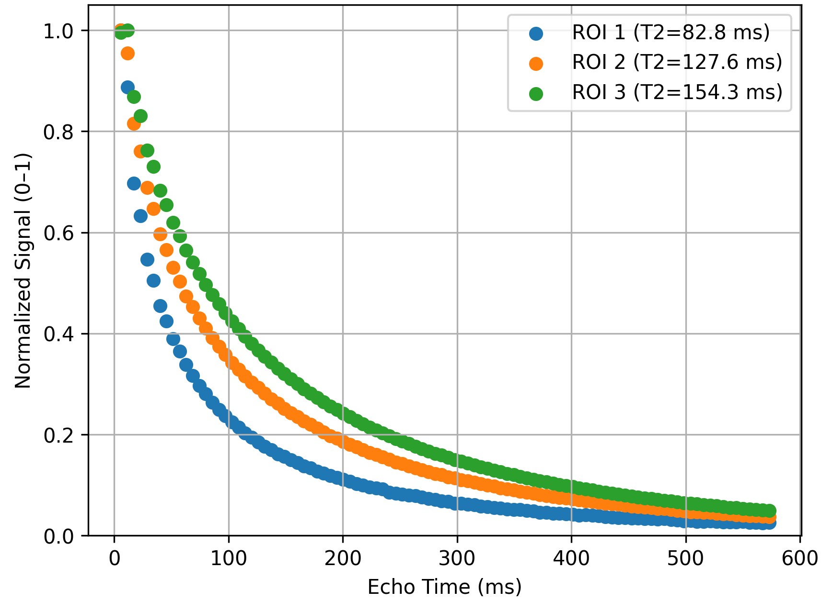
  Results: MRI data -Additional findings.
Applied signal intensity thresholding to extracted local residual water and hydrogen saturations
A clear T2 and T1 shift except in H2 rich regions
Extensive analysis on-going
1 hr after shut-in
23 hr after shut-in
Notes:
The goal is very broad, so we have worked to refine the scope into three key use cases

Slide 12
  Conclusions
Experimentally determined microbial hydrogen consumption rates of a sulphate reducer cultivated in sand pack columns
  Rates were 1-2 orders of magnitude higher than in reported literature batch bottle tests
Hydrogen consumption decreased with increase in storage time and storage cycle number
Increase in SSA correlated positively with microbial consumption rates especially in the first storage cycle- Consistent with dissolution rates
  Higher rates matched with shorter consumption intervals due to pH limitations
Observed improved storage capacity (Sw) between drainage cycles in non-sterile packs
Extensive MRI imaging and analysis on going to understand and quantify different phenemenon
Reduction in microbial activity with time in a storage cycle, and between storage cycle number shows a promising outlook for underground hydrogen storage in porous media suggests that hydrogen recovery efficiency and predictability improve over time.
Notes:
The goal is very broad, so we have worked to refine the scope into three key use cases

Slide 13















Thank you
CSSR is a collaboration between NORCE and the University of Bergen and receives funding from the Research Council of Norway (nr: 331841) and industry stakeholders.
ramus8091@uib.no
cssr.no

